Slide 2
Introduction to NYAIL
New York Association on Independent Living
Statewide, not-for-profit membership association of Independent Living Centers.
ILCs are unique disability-led, cross-disability, locally administered not-for-profit organizations, providing advocacy and supports to assist people with disabilities of all ages to live independently and fully integrated in their communities.
ILCs have been transitioning and diverting people from institutions for more than 20 years.
Notes:
NYAIL leads statewide Independent Living Center efforts to eliminate physical and attitudinal barriers to all aspects of life and to fight for the civil rights and full independence of all people with disabilities.
ILCs are community-based nonprofits provide vital services, advocacy, and supports to individuals
Run by, and for people with disabilities – serve people with all disabilities and of all ages
Services focused on helping people living independently in the community-
Core services such as benefits counseling, info & referral, housing assistance, peer counseling
Other services vary per center and communities needs – many MA funded services, OPWDD, OMH

Slide 3
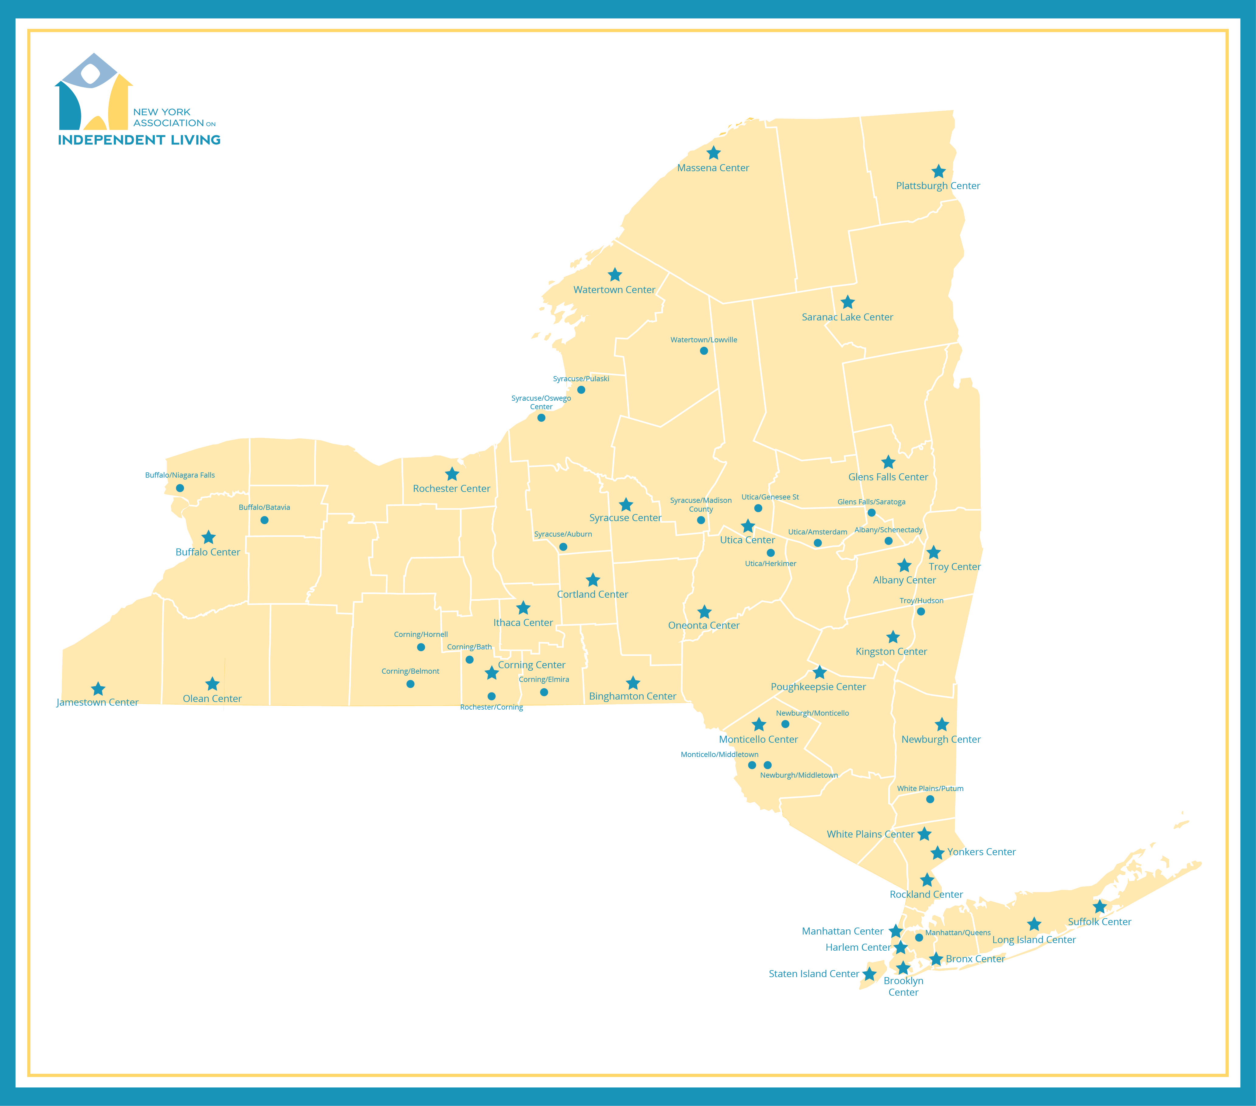
Notes:
42 ILCs across NYS with over 50 offices

Slide 4
NYAIL Programs
NYAIL administers several statewide programs in collaboration with its member ILCs:
Open Doors (Money Follows Person, MFP)
Transition Center - Transition specialists at ILCs across the state to directly assist people in nursing homes access the services they need to return to the community.
Peer Outreach and Referral - Peer advocates empowering people with disabilities and the elderly to take charge and make informed decisions about their lives.
Olmstead Housing Subsidy (OHS)
Statewide rental subsidy and transitional housing support service program for high-need Medicaid beneficiaries.
Rapid Transition Housing Program (RTHP)
Notes:
The New York Association of Independent Living administers several statewide and regional programs in collaboration with its member ILCs, all of which are focused on helping people with disabilities live independently in the community.
Open Doors (Money Follows People, MFP) - In 2014, NYAIL was selected by the Department of Health to coordinate the Open Doors Transition Center Project and Peer Outreach and Referral Program as part of State's Money Follows the Person (MFP) program. The programs are funded through the MFP Federal Rebalancing Demonstration Grant.
Olmstead Housing Subsidy (OHS) - Olmstead Housing Subsidy (OHS) is a statewide rental subsidy and transitional housing support service program for high-need Medicaid beneficiaries. NYAIL administers the program and partners with member ILCs to staff housing specialists across the state to provide outreach to and assist eligible individuals with OHS program enrollment.
Rapid Transition Housing Program (RTHP) - The Rapid Transition Housing Program (RTHP) is a rental subsidy and support services program for homeless, high-need Medicaid beneficiaries. NYAIL administers the Rapid Transition Housing Program in collaboration with its member ILCs in four areas of the state: Long Island, Syracuse, New York City and Rochester.

Slide 5
Rapid Transition Housing Program (RTHP)
Rapid Transition Housing Program (RTHP) provides rental subsidies for high-need Medicaid beneficiaries
Previously known as Nursing Home to Independent Living (NHIL)
Medicaid Redesign Team (MRT) initiative funded by the Department of Health (DOH) and administered by the New York Association on Independent Living (NYAIL).
RTHP ensures seniors and people with disabilities can afford accessible, safe, sanitary, and sustainable housing in the community.
Each participant will be assigned a Housing Specialist (HS) and an Independent Living Specialist (ILS)
Notes:
Housing Specialist’s assist participants with locating units and communicating with landlords.
Independent Living Specialist’s assist them with getting services put in place for when the participant is in their new home. Independent Living Specialists work with developing individualized services for individuals coming into the program.

Slide 6
How does RTHP work?
Provides ongoing rental subsidy
Locate units that are at or below Fair Market Rate (FMR) set by HUD
Individuals are required to pay 30% of their income and utilities (if not included)
Individual’s income must be at Extremely-Low Income as determined by HUD Annually
Community Transition Services (CTS) are available to pay for furniture, essential household furnishing, small e-mods
ILSs provide wrap around services to ensure participants are connected to providers/resources
Notes:
RTHP provides ongoing rental subsidy to individuals who qualify. This ensures that they are in a safe, sanitary, sustainable, and accessible living environment
Housing Specialists (HS) work with participants to locate units that are at or below FMR (Fair Market Rate) set by HUD (Housing and Urban Development)
Participants are required to pay 30% of their income and utilities (if utilities are not included in the cost of rent)
Income must be at Extremely-Low Income as determined by HUD Annually
Community Transition Services (CTS) are available to pay for furniture, essential household furnishing, small e-mods
Independent Living Specialists (ILS’s) provide wrap around services to ensure participants are connected to providers/resources

Slide 7
RTHP Locations
RTHP is available in four regions
Long Island
Suffolk Independent Living Organization (SILO)
Syracuse
ARISE
Rochester
Center for Disability Rights (CDR)
New York City Region (CIDNY/BCID/BILS)
Center for Independence of the Disabled, New York (CIDNY)
Brooklyn Center for Independence of the Disabled (BCID)
Bronx Independent Living Services (BILS)
Notes:
Long Island and Syracuse previously had RTHP through different organizations.
Rochester and NYC are brand new to the program.

Slide 8
RTHP Structure
Housing Specialists and Independent Living Specialists staffed at ILCs in the four regions
RCIL Fiscal Intermediary (Long Island and Syracuse)
NYAIL Staff-
Director of Housing Programs
Program Coordinator
Support Service Coordinator
Account Clerk
Program Assistant

Slide 9
RTHP Eligibility
Medicaid members with one or more documented chronic physical disabilities and have two or more chronic conditions (e.g., asthma, diabetes).
Are referred as homeless high-utilizers
Priority will be given to those who are awaiting an organ transplant and need emergency housing to meet waitlist requirements.
Notes:
Homeless high-utilizers are defined as:
Having two or more inpatient stays in the past 12 months or
Having five or more emergency department (ED) visits in the past 12 months or
Having four or more ED visits and one or more inpatient stay in the past 12 months or
Be within the top 20% of Medicaid recipients’ spending relative to the county of fiscal responsibility and target population parameters.

Slide 10
RTHP Referrals
Who can make referrals:
Hospitals
Managed Care Organizations (MCO)
Medical Respite
Performing Provider System (PPS)
Skilled Nursing Facility (SNF)
Referral forms are on our website at: https://ilny.us/programs/rapid-transition-housing.

Slide 11
RTHP: Information Needed to Determine Eligibility
Written Verification from Doctor/hospital discharge paperwork/health home/MMCO of:
Chronic Physical Disability
1st Chronic Disease
2nd Chronic Disease
Written Verification from hospital, MCO, medical respite, PPS, SNF of:
2 or more Inpatient Stays in Past 12 Months; or
5 or more ED Visits in Past 12 Months; or
4 or more ED Visits and 1 or more Inpatient Stays in Past 12 Months; or
Proof of Identity
Proof of Age
Notes:
Written Verification from Doctor/hospital discharge paperwork/health home/MMCO of:
Chronic Physical Disability
1st Chronic Disease
2nd Chronic Disease
Written Verification from hospital, MCO, medical respite, PPS, SNF of:
2 or more Inpatient Stays in Past 12 Months; or
5 or more ED Visits in Past 12 Months; or
4 or more ED Visits and 1 or more Inpatient Stays in Past 12 Months; or
Proof of identity (driver’s license, state-issued non-driver identification card, Medicaid card with picture, or notarized letter from the nursing home establishing identification)
Proof of age (driver’s license, state-issued non-driver identification card, Medicaid card with picture, notarized letter from the nursing home establishing identification, or birth certificate)

Slide 12
Eligibility continued…
Verify Medicaid enrollment, documentation from local DSS office
Income documentation
Verify participant run through state and federal sex offender registries
Verify participant run through NYS Inmate Population Information Search
Written description of why the participant needs RTHP assistance.
Include evidence of participant’s current housing, or evidence of participant’s living situation prior to program entry:
Nursing home/hospital discharge plan; or
Attestation by other community organizations that participant is homeless, include the name of the shelter or location where person has been observed to sleep and the number of days the participant has been observed to be homeless
Notes:
Verification of current Medicaid enrollment (ePACES check), and documentation from local DSS office showing spenddown amount (if applicable)
Income documentation (e.g. Social Security Administration (SSA) award letters, income statements, etc.
Verification participant’s name was run through state and federal sex offender registries:
Verification participant’s name was run through NYS Inmate Population Information Search
Written description of the circumstances by which the participant needs RTHP assistance, including evidence of participant’s current housing, or evidence of participant’s living situation prior to program entry, through one of the following:
a. Nursing home/hospital discharge plan; or
b. Attestation by other community organization that participant is homeless, including the name of the shelter or location where person has been observed to sleep and the number of days the participant has been observed to be homeless
Once participants meet the eligibility for the program, they will be referred by the HS to begin working with an ILS.

Slide 13
RTHP Housing Specialist Role
Complete intake
Determine eligibility
Locate and secure units, inspection: units are to be within FMR (Fair Market Rent) for the area
Provide needed items (deposit, 1st month rent, CTS dollars)
Maintain monthly contact
Annual unit inspection
Assist with problem solving
Links within community for services
Maintain program database
Resource for Landlords
Notes:
Complete intake, collect forms
Determine eligibility
Locate and secure units, complete inspection
Units to be located are to be within FMR (Fair Market Rent) for the area they are moving to.
Provide needed items (security, 1st month rent, Community Transition Service dollars)
Maintain monthly contact
Annual unit inspection
Assist with solving barriers
Linkages within the community for services
Maintain the database
Resource for Landlords

Slide 14
RTHP Independent Living Specialist Role
Collaborate with applicant’s Discharge Planner, Care Manager and/or Service Coordinator to ensure services and supports are available to serve the individual
Prior to discharge, work with individuals to develop an Individualized Service Plan (ISP).
Establish monthly contact to ensure participants have the needed service in place and are working.
Provide independent living skills training, individual advocacy and other ongoing services as needed.
Notes:
Work collaboratively with applicant’s Discharge Planner, Care Manager and/or Service Coordinator to ensure the necessary services and supports are available to safely serve the individual in the community with RTH.
Prior to discharge, work with individuals to develop an individualized service plan (ISP).
Ensure services are in place for participants
Establish monthly contact to ensure participants have the needed service in place
Provide independent living skills training, individual advocacy and other ongoing services and supports as needed.

Slide 15
Community Transition Service Dollars (CTS): What’s Covered
The cost of moving essential furniture and other belongings through a licensed, certified (by NYS Dept. of Transportation) moving company.
Security deposits, broker’s fees, application fees, and redecorating fees required to obtain a lease on a unit.
Grab bars, portable ramps, and minor accessibility modifications.
Set-up fees or deposits for utility or service access (e.g. telephone, electricity, heating).
Basic essential furnishings (e.g. bed, table, chairs, essential food preparation items and eating utensils; including delivery and assembly)
Notes:
The cost of moving essential furniture and other belongings through a licensed, certified (by NYS Dept. of Transportation) moving company.
Security deposits, broker’s fees, application fees, and redecorating fees required to obtain a lease on a unit.
Grab bars, portable ramps, and minor accessibility modifications.
Set-up fees or deposits for utility or service access (e.g. telephone, electricity, heating).
Basic essential furnishings (e.g. bed, table, chairs, essential food preparation items and eating utensils; including delivery and assembly)

Slide 16
New York Association on Independent Living
Rapid Transition Housing Program Contact Information
Phone: 518-465-4650
Fax: 518-465-4625
Director of Housing Programs: Valerie Brennan
Program Coordinator: Vincent Negri
Support Service Coordinator: Krystina Rodriguez
Program Assistant: Renee Mayer
Visit our website at www.ilny.org
Like us on Facebook!
https://www.facebook.com/#!/NYAIndependentLiving

