Slide 1

Best Practices:
Person-Centered
Housing-Focused
Case Management
Alexis Goglas, MSW- Supervisor of Direct Support
Carrie Garcia- CoC Training and Support Manager
Jessica Labia, LMSW- Director of Support Programs
Long Island Coalition for the Homeless
December 19th, 2024

Slide 2

Pre-test
Please take 2 minutes to complete the Pre-test!

Slide 3
Learning and Objectives
Build
Build rapport and assess client needs effectively.
Understand
Understand Housing First principles and their application.
Develop
Develop tailored housing plans based on client preferences.
Connect
Connect clients to housing resources and supportive services.
Employ
Employ crisis intervention strategies to support clients.
Foster
Foster collaboration with local agencies and service providers.
Measure and Evaluate
Measure and evaluate outcomes of case management efforts.
Apply
Apply cultural competency and ethical practices.

Slide 4

Reflection of a time that someone close to you received care/support
Positives
Negatives
Notes:
It could be personal health care, support services, or any experience where they felt seen and understood.
Now, write down (or share aloud, if comfortable) one thing that made that experience stand out. Think about what they did to build a good relationship with you.
What did they NOT do during the relationship?
Is there a time that anyone has expressed feeling this way about you?
For example, it could be a personal touch, a moment when they felt listened to, or when care providers took the time to understand their unique preferences.

Slide 5
What is Housing-Focused Case Management?
Orienting case management support to end someone’s homelessness crisis.
Key principles to focus case management on housing activities include:
1. Housing First - Housing is a basic human right
2. Person-centered - tailored services driven by client choice
3. The relationship between the client and case manager is foundational
4. A focus on activities that help people move out of homelessness

Slide 6
Why Housing-Focused Case Management?
Financial Need:
NY has about 34 affordable housing units for every 100 extremely low-income household who qualifies - this meets about 30% of the need.
74% of NY’s extremely low-income households spend over 50% of their income on rent each month.
Supportive Need:
Homelessness is a loss of essential human needs and experiencing it creates complex trauma.
This trauma creates an environment wherein people are in “fight or flight” making navigating the necessary systems difficult.
40% of individuals experiencing homelessness have a chronic health condition, and 25% have a serious mental illness. These factors often require coordinated care and personalized housing case management to ensure stability. (NAEH)
Positive Impacts/Evidence:
Studies have consistently shown that housing case management improves housing stability. For example, the Supportive Housing Program (a program involving case management for people experiencing chronic homelessness) has been shown to reduce homelessness by more than 80% in participants over the course of a year.
A study published in the American Journal of Public Health found that people who received housing case management had significantly lower rates of recidivism to homelessness (i.e., they were less likely to return to homelessness once housed) compared to those who did not receive such services.
Public Spending Need:
Supportive housing with case management reduces costs related to emergency services and hospital admissions by up to 50%.(NIH)
Supportive housing (which includes case management) saved communities between $5,000 and $13,000 per person per year in public costs (such as emergency room visits, criminal justice system involvement, and shelters).(NAEH)

Slide 7
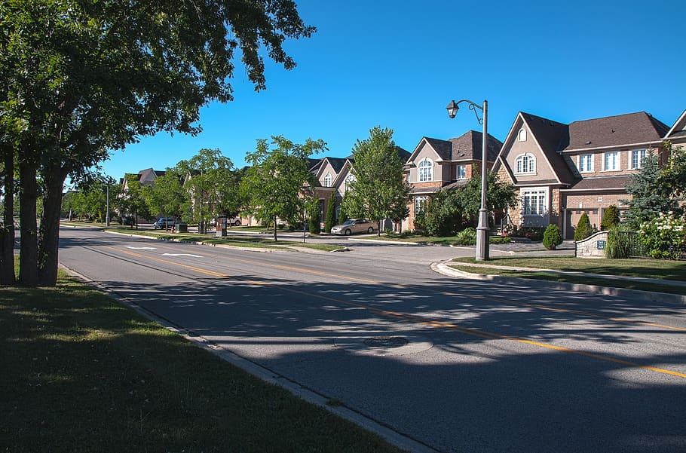
Housing-Focused Case Management Key Concepts
Client-Focused Approach: Places the client at the forefront of the process. CM’s work closely with clients to understand and try to best meet their unique needs and preferences.
Housing First Philosophy: Working to help clients obtain safe, stable, permanent housing without preconditions and working to overcome barriers many individuals may face when trying to access housing
Strengths-Based Approach: Placing a focus on the client’s strengths, abilities and potential as opposed to their perceived deficits. Encouraging clients by highlighting these strengths when working to overcome barriers.
Continuous Support: Recognizing that housing stability is an ongoing process and continuing to provide flexible support as needed once housing is obtained.
Community Integration: Encouraging clients to integrate with their community upon obtaining housing and helping them with establishing a support network within their community.
Advocacy: Helping clients to navigate difficult systems while on their housing search and beyond.

Slide 8

Why Person-Centered Case Management?
Empowerment and Client Satisfaction
The Institute for Community Health in Massachusetts found that people experiencing homelessness who engaged in person-centered case management reported higher levels of satisfaction with their housing and services. About 80% of participants felt empowered to make decisions regarding their housing and services, which led to increased adherence to housing stability plans.
Client empowerment through person-centered approaches leads to better engagement with case managers, as individuals are more likely to participate in their own care and treatment when they have a role in setting goals. Studies show that when people experiencing homelessness are involved in their case management planning, they have higher engagement rates in the services provided, including employment and rehabilitation programs.
Improved Housing Stability
Person-centered case management emphasizes creating individualized plans and empowering clients to set their own goals, which has been shown to improve housing outcomes. A study from the National Alliance to End Homelessness found that 80% of individuals participating in person-centered case management programs were able to maintain stable housing for at least one year after placement in supportive housing programs.
According to the HUD’s Homeless Management Information System (HMIS), supportive housing programs with a person-centered approach report higher housing retention rates, with some programs seeing retention rates as high as 85% over a 12-month period.
Reduction in Homelessness Recidivism
Person-centered case management helps individuals navigate barriers such as health issues, joblessness, and substance use through a tailored approach. This significantly reduces the likelihood of returning to homelessness. A study published in the American Journal of Public Health found that individualized case management led to a 60% reduction in the likelihood of people returning to homelessness after being housed.
The National Coalition for the Homeless also highlights that people who engage in person-centered case management are 40% less likely to experience homelessness again within two years compared to those who receive less personalized services.
Better Health Outcomes
Homeless individuals often face a range of health issues that can be better addressed through person-centered case management. For example, a study by the National Health Care for the Homeless Council found that 60% of individuals who received person-centered case management services reported improved mental health outcomes and access to health care, compared to 45% in traditional case management programs.
Chronic health conditions are prevalent among the homeless population. According to the National Institute on Drug Abuse, up to 40% of homeless individuals suffer from chronic medical conditions, which can be better managed when services are personalized to the individual’s specific health needs.

Slide 9

Person-Centered Case Management Key Concepts
Client-Focused Approach: Prioritizing the client's needs, preferences, and goals above all else and being sure to actively involving them in decision-making.
Empowerment: Supporting the client to take ownership of their situation, develop coping mechanisms, and advocate for themselves.
Active Listening: Fully focusing on and attentively responding to a client's concerns, thoughts, and feelings
Collaboration: Working with the client to reach their goals. (Remember, this is their life, and they should be an active participant throughout this process.)
Individualized Support: Case managers work with clients to develop personalized plans, focusing on the specific barriers they face in maintaining housing (e.g., mental health, addiction, employment issues).
Clear, and Respectful Communication: Being sure to consistently check in with a client and explain the process to them in a manner they can understand.
Avoiding Punitive Measures of Accountability: While bound to follow regulations, bear in mind the more punitive we are the more strained a relationship with a client will be.
Trauma Informed Care: Case managers work on creating a safe, empowering environment that recognizes and responds to the impact of trauma on clients’ behaviors and needs.
Strengths Based Approach: Case managers focus on identifying and leveraging a client’s existing strengths and resources to empower them in overcoming housing challenges and achieving stability.
Resource Connection: Case managers connect clients with necessary services like mental health care, addiction treatment, job training, or financial assistance.

Slide 10
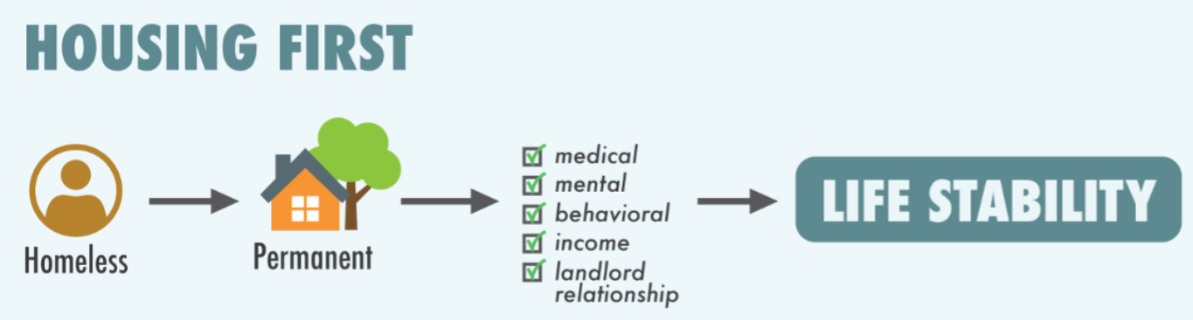
Housing First:
Five Core Principles:
Immediate access to permanent housing with no housing readiness requirements: Individuals are provided with stable, long-term housing without preconditions, ensuring they have a safe place to live.
Participant/client choice and self-determination: People are empowered to make their own decisions about their housing and services, fostering autonomy and control.
Recovery orientation: The approach emphasizes personal recovery and well-being, recognizing that individuals can improve and lead fulfilling lives while living in stable housing.
Individual and participant/client-driven supports: Tailored, flexible support services are provided to meet the unique needs of each person, promoting long-term stability.
Social and community integration: Efforts are made to connect individuals with their communities, reducing isolation and supporting social inclusion.
“Housing First is a homeless assistance approach that prioritizes providing permanent housing to people experiencing homelessness, thus ending their homelessness and serving as a platform from which they can pursue personal goals and improve their quality of life. This approach is guided by the belief that people need necessities like food and a place to live before attending to anything less critical, such as getting a job, budgeting properly, or attending to substance use issues. Additionally, Housing First is based on the understanding that client choice is valuable in housing selection and supportive service participation, and that exercising that choice is likely to make a client more successful in remaining housed and improving their life.” (The National Alliance to End Homelessness)

Slide 11
Best Practices for Promoting Client Autonomy
Partnership:
this is a collaboration and the client’s expertise in their own life should be just as recognized as the CM’s expertise in their work.
Acceptance:
Prioritizing a client’s worth and acknowledging their strengths and potential.
Compassion:
Promoting a client’s welfare, actively listening to their choices in an empathetic way and prioritizing their needs.
Evocation:
Eliciting a client’s own knowledge, wisdom, motivations and strengths.

Slide 12
Tips for Building Rapport with Clients
Offer Privacy
Make Eye Contact
Engage in Active Listening
Meet Clients Where They’re At/Go at Their Pace
Follow Up and Follow Through

Slide 13
Effective Communication Strategies
Active Listening
Shows respect and empathy, builds trust, and helps case managers better understand the client's needs and desires.
Empathy and Compassion
Helps the client feel understood, supported, and motivated to engage in the case management process.
Using Open-Ended Questions
Allows clients to share more about their thoughts, feelings, and needs, which provides valuable insights into their unique situation.
Presenting Information Clearly and Concisely
Helps clients make informed decisions and reduces confusion, ensuring that they understand the resources, services, or next steps available to them.
Practicing Cultural Sensitivity
Helps to avoid misunderstandings, build trust, and create a more inclusive environment for the client.
Effective and Intentional Use of Non-Verbal Communication
Reinforces the message being communicated and helps to build rapport.

Slide 14
Effective Communication Strategies
Promoting Collaborative Dialogue
Fosters empowerment within clients, giving them a sense of ownership over the case management process and their goals.
Respecting Client’s Autonomy
Clients are more likely to engage in and commit to their plans if they feel their autonomy is respected.
Encouraging Feedback and Reflection
Reinforces that the case manager is paying attention and fosters deeper conversations, ensuring that both parties are aligned.
Positive Reinforcement and Encouragement
Can help boost a client’s self-esteem and motivation to continue working toward their goals.
Building Trust and Ensuring Confidentiality
Ensuring that a client’s information is kept confidential promotes trust, which is crucial for open communication and a successful case management relationship.
Following up
Helps the client feel supported and reduces feelings of abandonment, reinforcing the idea that they are not alone in their journey.

Slide 15
Crisis Intervention Strategies
What is a crisis?
Crisis is a state of feeling; an internal experience of confusion and anxiety to the degree that formerly successful coping mechanisms fail us, and ineffective decisions and behaviors take their place.
Techniques for De-Escalating Challenging Situations
The Crisis Prevention Institute (CPI) reports to have 10 de-escalation tips:
1. Be empathetic and non-judgmental
2. Respect Personal Space
3. Use Nonthreatening Nonverbals
4. Keep your emotional brain in check
5. Focus on feelings
6. Ignore challenging questions
7. Set limits
8. Choose wisely what you insist upon
9. Allow silence for reflection
10. Allow time for decisions

Slide 16
Four Action Steps in Navigating Crises
Prepare
Participate in trainings
Reflect
Create a crisis response plan
Use your supervisor as a resource
Engage
Evaluate for safety
Provide time and space
Remain calm
Avoid arguments and power struggles
Minimize new information
Listen
Provide undivided attention - Do not interrupt
Delay problem solving - Paraphrase
Validate - Reserve judgement
Link
Gently but firmly re-establish boundaries
Focus on what you can do
Offer to bring your supervisor or another specialist
Explore coping strategies and grounding activities
Collaborate to establish at least one concrete next step
Think: I know some relevant information that might help. I know my crisis response plan.
Say: “What is your biggest priority right now?”
Think: Deep Breath. Stay Calm.
Say: “This sounds like a very hard situation. I’m hearing that you are really frustrated.”
Say: “Let’s think about one thing we can plan to do that might help.”

Slide 17
Example
Sarah walks into a local community mental health clinic one afternoon, visibly distressed and trembling. She is wearing a worn jacket, and her eyes appear red from crying. Sarah explains that she is currently homeless, having been living in her car for the past two weeks. She reports that she had to leave her last temporary housing situation after an altercation with a roommate who was involved in substance use. Sarah has not been able to find any other place to stay and is overwhelmed with anxiety and fear about her safety. She is in crisis because she has been feeling increasingly hopeless and disconnected, and she is afraid of becoming completely isolated.
She tells you that she has been struggling with feelings of despair and has been drinking more frequently to cope with the stress. She says that she’s “had enough” and feels trapped in her circumstances. At one point, she mentions thoughts of harming herself but quickly states that she doesn't have a plan or intention to act on it. However, she feels completely alone and unsure where to turn next.

Slide 18

Reflection
  Prepare
    Participate in trainings
    Reflect
    Create a crisis response plan
    Use your supervisor as a resource
  Engage
    Evaluate for safety
    Provide time and space
    Remain calm
    Avoid arguments and power struggles
    Minimize new information
  Listen
    Provide undivided attention
    Do not interrupt
    Delay problem solving
    Paraphrase
    Validate
    Reserve judgement
  Link
    Gently but firmly re-establish boundaries
    Focus on what you can do
    Offer to bring your supervisor or another specialist
    Explore coping strategies and grounding activities
    Collaborate to establish at least one concrete next step
How would you react to the previous situation using the 4 action steps?

Slide 19
Housing Problem Solving Questions to Keep in Mind
“Is there anyone that may want to know that you need help?”
“Do you have family, friends or anywhere to stay?”
“Tell me about past places you’ve stayed that have been safe and positive.”
“Where was the last place you stayed where you felt safe? Would it be safe to stay again?
“Tell me about any strengths you have to navigate this difficult situation you are facing at this time.”
“What support, resources, or money would you need to stay somewhere else or make a housing option work?”

Slide 20
Housing Problem Solving
Situation: Stevie comes into your office visibly stressed. They shared that they were recently kicked out of their apartment after falling behind on rent. They had been working for a food delivery company, but when they could no longer afford their car payments, they lost their car. Without their car, Stevie lost their only source of income. Now, they don’t know where to go and, feeling out of options, they have decided to stay at a local shelter for the night.
  How would you approach the initial conversation with Stevie?
  What are some questions you might ask when you start housing problem solving?

Slide 21
Conversation with Stevie
Case Manager (CM):
"Hi Stevie, thanks for sharing your situation with me. I can hear that you’ve been going through a tough time. Losing your apartment and your car, along with your income, must feel overwhelming. Let's see what we can do to help you get back on track. I’d like to start by talking about what we can do to secure housing for you right now and look into ways to help with income recovery. Does that sound okay?"
Stevie:
"Yeah, that sounds good. I honestly don’t know where else to go. I found the shelter, but I’m not sure what my next steps are."
CM:
"You're in the right place. Let’s break this down into manageable steps. First, we’ll look at your housing options. I can help you apply for emergency housing through the Department of Social Services. Second, we’ll talk about what housing program you may be eligible to apply for and talk about how to help you find income again. There may be some local resources or job training programs that can assist. Would it be helpful if I helped you contact the shelter to make sure they have space for you tonight, and we can also get the ball rolling on housing and income support?"
Stevie:
"That would be great. I didn’t know where to start."
CM:
"Perfect. Let's take it one step at a time. We’ll start with finding stable housing options and then work on getting your income back on track. I’ll help you with everything you need."

Slide 22
Checklist: Housing-Focused Activities
Case management activities that can help people exit plan. Explore all of these with every client simultaneously, continuously and repeatedly.
❑ Housing problem-solving (reuniting with friends, family, relocating)
❑ Explore service settings
❑ Apply to subsidized housing
❑ Refer priority populations to Coordinated Entry
❑ Consider shared housing or private market housing
❑ Maximize income and benefits
❑ Obtain important documents
❑ Overcome tenant screening barriers (references, expungement, etc.)

Slide 23
Understanding Housing Preferences
Learning a participant’s housing preferences allows us to understand their needs, desires, and priorities. This leads to greater satisfaction, housing stability and improved quality of life (NAEH, 2022).
What will the household composition be once in permanent housing?
Location Preferences:
Towns household is and isn’t comfortable living in
Willingness to relocate to a different town, county, or even state
Need to be near medical supports
Accessibility to public transportation
Accommodations Needed:
Wheelchair or handicap accessible
Space for medical bed or equipment
Are pets allowed?
Are support services needed?
Contribution of Rent:
Is household able to pay at least 30% of their income towards rent?
Can household afford more than 30%?
If household is not able to pay 30%, what can they afford to contribute?

Slide 24

Identifying Barriers to Housing & Overcoming Them
There are many barriers that a household may face in accessing permanent housing. Including, but not limited to:
  Credit score
  Health problems
  Financial challenges
  Criminal history
  Previous housing history (eviction)
  Limited access to transportation
  Difficulty budgeting

Slide 25
Developing Individualized Housing/Service Plans
Components of an individualized service plan
Housing Stability
Health and Wellness
Employment and Financial Stability
Targeted Goals
Housing Stability
Rebuild Housing History
Permanent Housing
Health and Wellness
Maintain Sobriety
Mental Health
Family Reunification
Employment and Financial Stability
Obtain Employment
Maintain Employment for Minimum of 6 Months
Repair Credit History
Financial Stability

Slide 26
Goal Setting & SMART GOALS
• “Specific – Objective clearly states, so anyone reading it can understand, what will be done and who will do it.
• Measurable – Objective includes how the action will be measured. Measuring your objectives helps you determine if you are making progress. It keeps you on track and on schedule.
• Achievable – Objective is realistic given the realities faced in the community. Setting reasonable objectives helps set the project up for success
• Relevant – A relevant objective makes sense, that is, it fits the purpose of the grant, it fits the culture and structure of the community, and it addresses the vision of the project.
• Time-bound – Every objective has a specific timeline for completion.”
https://www.samhsa.gov/sites/default/files/nc-smart-goals-fact-sheet.pdf

Slide 27

Question
What is an example of a SMART goal that you have worked on with a client regarding their housing plan.

Slide 28

Important Documents
(b) Proof of Birth. One of the following proof-of-birth
documents (shown in order of preference) for all
Applicant Family members:
(1) Original and copies of Birth certificates;
(2) Passports;
(3) Original INS documents for eligible Non-Citizens;
(4) Other records deemed appropriate by PHA (DDG214, Statement from Social Security Administration, Original Baptismal Records); or
(5) A medical letter documenting pregnancy as well as anticipated date of birth will be required for all unborn children listed on the application.
(a) Photo Identification for the Head of Household
and the Co-Head of Household.
(1) Driver’s License;
(2) Registry of Motor Vehicles picture ID;
(3) Passport;
d) Social Security Numbers. One of the following
documents may be accepted to verify Social Security
Numbers (SSN):
(1) Original Social Security Card;
(2) Original Report from the Social Security
Administration documenting the
availability/non-assignment of a SSN ; or
(3) A written statement from the Social Security
Administration documenting the assigned SSN.
Family members under the age of six (6) years old do
not need to provide a SSN.
(c) Proof of Relationships. One of the following proof-of-relationship documents for all Minor children or situations involving the care of adults under guardianship:
▪ (1) Birth certificates;
▪ (2) Court records of adoption;
▪ (3) Court records of guardianship; or
▪ (4) Other written documentation such as written designation from the Minor Child’s parent.
(b) Proof of Birth. One of the following proof-of-birth
documents (shown in order of preference) for all
Applicant Family members:
(1) Original and copies of Birth certificates;
(2) Passports;
(3) Original INS documents for eligible Non-Citizens;
(4) Other records deemed appropriate by PHA (DDG214, Statement from Social Security Administration, Original Baptismal Records); or
(5) A medical letter documenting pregnancy as well as anticipated date of birth will be required for all unborn children listed on the application.

Slide 29

Sealing Criminal Records
What Does Sealing A Conviction Do?
The record of a criminal conviction will still exist but will be hidden from the public. The only people who can see a sealed conviction are:
● you or someone you give permission to
● employers only when you apply for a law enforcement job
● government agencies carrying out court and law enforcement duties (like immigration or probation)
● government agencies when you apply for firearm licenses
● the FBI when running background checks related to firearm possession or purchase
Eligibility to Seal
CPL 160.59 allows people with two or fewer convictions
to apply to seal their record. To seal your record all of the
following must be true:
● You have no more than two criminal convictions in your
lifetime. If you have more than two convictions, you may still be
eligible if your convictions are related to the same one or two incidents.
● You have no more than one felony conviction.
● At least 10 years have passed since you were sentenced for your last conviction or since you were incarcerated (whichever is later.)
https://ag.ny.gov/resources/individuals/civil-rights/sealing-your-criminal-record
Notes:
Having a criminal record can make it difficult to achieving goals like employment and housing. Looking into sealing records to alleviate some of these barriers is worth exploring!

Slide 30

NAVIGATING HOUSING RESOURCES

Slide 31
Coordinated Entry
What is Coordinated Entry?
The process of assessing and prioritizing resources specifically dedicated to people experiencing homelessness. On Long Island, the operators of CE are the Long Island Coalition for the Homeless and the Safe Center of Long Island.
Since there are not nearly enough housing resources on
Long Island for everyone who needs it, Coordinated Entry
is responsible for the prioritization of those who display the
highest vulnerability to remaining homeless.
On Long Island, priority populations are:
Longest length of time homeless
People fleeing domestic violence
Refer people who are fleeing domestic violence and/or who have at least 1 year of shelter or unsheltered homelessness. People outside of the priority populations may go through an assessment but may not reach the top of the queue.

Slide 32
Coordinated Entry
Domestic Violence Coordinated Entry
DV-CES Referral Form (linked)
Recommended that you complete alongside your client
For an overview of the referral system and how to make a referral, follow this link
You can submit a PDF version of the referral form via e-mail to DVCES@tscli.org
24/7 Hotline (516-542-0404) may be contacted if referral assistance is needed
Non-DV Coordinated Entry
“Access points” include:
‣ Shelter Case Managers
‣ Street Outreach Workers
‣ The Helpline (631-464-4314 ext. 118)
FAQs (linked)
CE training (linked)

Slide 33
Housing Resources through Coordinated Entry
Type | Description
Permanent Supportive Housing (PSH) | Permanent Supportive Housing (PSH): eligible households would have documented disabilities and a minimum of 12 months or more of homelessness on LI. Units are paired with intensive supportive services, for as long as the client remains in the housing (“forever services”). • Very low barrier screening • Rent is calculated at between 30% of one’s gross income
Rapid Re-Housing (RRH) | Rapid Re-housing (RRH): Temporary rental assistance (3-24 months) to give people a boost into the private market. RRH comes with housing search, stabilization case management to support people in their homes and help them transition off RRH assistance. • Very low barrier screening • Rent is calculated based on a client’s individualized housing stability plan
CoC/OMH Supported Housing SPA | SPA Supported Housing is housing for singles, couples, or families with adults who have serious mental illness. Support services via case management for as long as client remains in housing Rent is calculated at between 30% of one’s gross income
Empire State Supportive Housing Initiative (ESSHI) | Supported Housing Programs for people experiencing homelessness and among qualifying subpopulations (HIV/Aids/ MRT, physically disabled, seniors). Support services via case management for as long as client remains in housing Rent is calculated at between 30% of one’s gross income

Slide 34
Housing Resources for People with Substance Use Conditions
Sober recovery options:
  Talbot House Chemical Dependence Stabilization Center - https://www.catholiccharities.cc/index.php?option=com_content&view=article&id=21&Itemid=119
  OUTREACH Residential services - https://opiny.org/residential-adults/
  Salvation Army - https://www.salvationarmyusa.org/usn/rehabilitation/
SAIL OASAS MRT Supported Housing Program- https://www.sailservices.org/supported-housing
  Program SAIL has collaborated with Mercy Behavioral Health Services for the provision of services to individuals with a co-occurring disorder of substance abuse and mental illness (with substance abuse being the primary diagnosis). SAIL provides the housing services and supports and Mercy provides the clinical treatment to the individuals in the program.
OASAS Housing Providers: https://oasas.ny.gov/support-services?f[0]=location_filter_term%3A321&page=0

Slide 35
Housing and Other Resources for Seniors
Family- Type Home for Adults (FTHA)
FTHAs are an adult care facility in which an operator provides residential care, personal care and/or supervision services, in the operator's own home, to four or fewer adults who are not related to the operator.
An FTHA provides a home-like living environment. It is a community-integrated and supported housing alternative for dependent adults who cannot live alone any longer due to advanced age, developmental disabilities, or physical or mental health, but who do not require skilled medical or nursing services.
Find a Family-Type Adult Home:
Coordinator of Nassau County: Lorenzo Aufiero, 516-227-8217
Coordinator of Suffolk County: Sandra King-Moeck, 631-854-3192
Federally Assisted Housing Complexes in Suffolk for Seniors
  https://www.huntingtonny.gov/filestorage/13751/16461/18802/18824/Susidized_Senior_Housing_(Issued_by_Suffolk_County).pdf
Catholic Charities Housing for Seniors - https://www.catholiccharities.cc/how-we-can-help/housing
Additional Supports and Resources for Seniors:
Family Service League Senior Resources
United Way Safe at Home for Seniors
Long Island Senior Resources
Suffolk County Office for the Aging
New York State Office for the Aging
Long Island Cares Senior Food Resources

Slide 36
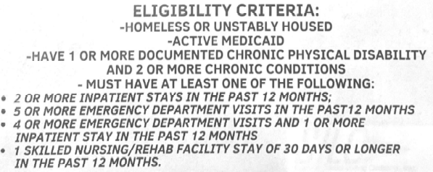
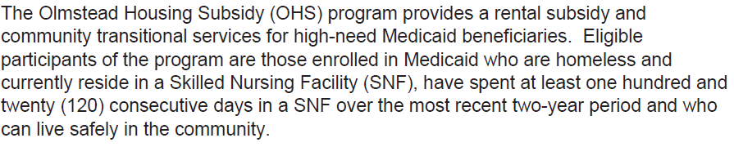
Housing Resources for People with Disabilities
Catholic Charities Thea Bowman Reside- housing for people with disabilities
Catholic Charities Housing Department
Telephone: 516-733-7076
Monday - Friday, 9 a.m. - 5 p.m
https://www.catholiccharities.cc/how-we-can-help/office-of-persons-with-disabilities
Suffolk Independent Living Organization (SILO) –
Rapid Transition Housing Program (RTHP)
Assisted Livings
Suffolk Assisted livings that accept Medicaid - https://suffolkcountyny.gov/portals/3/Docs/Assisted%20Living%20Facilities%206-2019.pdf
Nassau Assisted Living that accepts Medicaid - https:/www.longbeachalp.com/medicaid-assisted-living-nassau-county/
Olmstead Housing Program

Slide 37

Housing for People for with HIV/AIDs
The United Way of Long Island
Options for Community Living
Catholic Charities
TSLI HHB Permanent Housing Program

Slide 38
Housing for People with Serious Mental Illness
Commonly approved SMI diagnoses
Schizophrenia
Schizoaffective Disorder
Bipolar Disorder
Major Depression Disorder (MDD) recurrent *clients with this diagnosis should have strong hx of mental health treatment and support or psych hospitalizations
*these diagnoses would all be considered “Axis I”
SPA Housing
This is housing for individuals, couples, or families who are experiencing homelessness and have a Serious Mental Illness (SMI) diagnosis.
https://www.spahousingli.org/

Slide 39
Housing and Other Veteran Resources
Services for the Underserved (SUS) – SSVF. See https://sus.org/our-services/veterans/
EOC of Suffolk – SSVF. See https://eoc-suffolk.com/supportive-services-veteran-families-long-island/
Suffolk County Veteran Service Agency: can help veterans explore housing options
  https://www.suffolkcountyny.gov/veterans/Housing
United Veterans Beacon House (UVBH)- https://uvbh.org/residential-programs/
New York State Homes for Veterans Program- “SONYMA, in conjunction with the New York State Department of Veterans' Affairs, is pleased to offer the Homes for Veterans Program that will enable more U.S. military veterans and active duty U.S. military personnel to buy their first home. The program offers low interest rates & lower closing costs than the traditional VA Home Loan”
Veteran Affairs (VA)- https://www.va.gov/housing-assistance/
Veteran Assistance Supported Housing (VASH)- Housing Choice Vouchers for Veterans- https://veterans.ny.gov/supportive-housing-hud-vash-program
Assisted Living for Veterans on LI- https://thearborsassistedliving.com/veterans/?utm_source=Google&utm_medium=PPC&utm_campaign=HibuSearch&useYB=1,2,3,4,5,6

Slide 40

Navigating Other Housing Resources
Additional Housing Resources
  https://affordablehousingonline.com/
https://www.lihp.org/rentals.html
Affordable Housing Search - https://hcr.ny.gov/find-affordable-housing
County-level rental assistance:
  Town of Babylon Mortgage Arrears Program - https://www.lihp.org/babylonmtgarrears.html
  Town of Babylon Rental Assistance Program - https://www.lihp.org/BabylonTBRA.html

Slide 41

Private Market Housing: Search Tips
▪ Housing search is proactive and continuous
To find landlords and rental units:
  Neighborhood newspapers, esp. listserv subscriptions
  Housing search engines:
    Zillow
    Apartments.com
    Trulia
    Spareroom.com
    Hotpads
To keep landlords in a competitive market…
  Develop and maintain landlord relationships
  Return calls quickly
  Break down services, benefits, or features of your program
  Access any landlord funding in your community- bonuses, damages, etc.

Slide 42
Understanding Tenant Rights
Many households are eager to exit shelter and move forward with their lives in new homes. Sometimes, this can lead to clients overlooking red flags. It is important for CMs to educate clients on their rights to prepare to be tennats
Make sure clients understand their rights, and what to look for in a habitable, safe unit.
Some basic tenant rights:
Landlords can only ask for security equal to one month rent. Landlords cannot ask for security, first month and last months rent.
For tenants in units for less than one year, your landlord must provide you with 30 days advance notice before raising your rent or not renewing
For tenants in units for two years, your landlord must provide you with at least 60 days
For tenants in units for two years or more, your landlord must provide you with at least 90 days notice
A rent payment can only be considered late if it is received more than five days after it is due.
The most your landlord can charge as a late fee is $50 or 5% of your monthly rent, whichever is less.
For more information on tenant rights- Residential Tenants Rights Guide: Renters Rights and Protections Under New York State Law

Slide 43
Navigating Various Resources
Income maximization, public benefits, and/or job search agencies/employment programs:
  Overview of NY’s TA Benefits - https://otda.ny.gov/programs/temporary-assistance/
  SSI/SSDI - https://www.ssa.gov/apply
  NY’s State Supplement Program (SSP) - https://otda.ny.gov/programs/ssp/
Employment-related resources:
  EOC of Nassau - 5 family development centers that help low-income families gain employment. See https://www.eoc-nassau.org/family-development-centers
  EOC of Suffolk - 3 family development centers that help low-income families gain employment. See https://eoc-suffolk.com/family-development/
  Hempstead Works - https://www.hempsteadworks.com/
  Dress for Success - https://brookhaven.dressforsuccess.org/
Care coordination services:
  Health Home Program - https://www.health.ny.gov/health_care/medicaid/program/medicaid_health_homes/
Emergency Shelter Learning Series (NAEH) https://endhomelessness.org/resource/emergency-shelter/
Housing Search Assistance Toolkit (HUD Exchange) https://www.hudexchange.info/resources/housingsearchtool/?housingsearchtoolaction=public:main.landlord-outreach-and-recruitment-resources

Slide 44
Roleplay

Slide 45
Scene:
The client, Lana, has come into the office for her bi-weekly check-in with her housing case manager, Jordan. They are sitting at a desk, with papers scattered about regarding Lana's housing situation. Jordan is trying to help Lana move forward with securing permanent housing, but Lana seems resistant to follow the plan or listen to suggestions.
Case Manager (Jordan):
"Good afternoon, Lana. How are you doing today?"
Client (Lana):
Sighs loudly, crossing arms.
"How do you think I’m doing? Nothing’s changed, and I’m still stuck in this dump of an apartment. I don’t even know why I’m bothering to come in here every week. You’re not really helping me, are you?"
Case Manager (Jordan):
"I understand it’s been a frustrating time for you, Lana, but we’ve made some progress. You were able to submit the application for the voucher last week, and we're still waiting on approval. I’m confident we’ll hear back soon."
Client (Lana):
Throws hands up in exasperation.
"Yeah, but who knows when that’ll be? I can’t live like this forever. This place is falling apart. The landlord won’t fix anything, and you’re telling me to just wait. I can’t just sit around and wait, Jordan! I need real solutions!"
Case Manager (Jordan):
"I totally get that you need more stability. The thing is, we need to work within the system to get you where you want to be. I know it feels slow, but we’re doing everything we can to make sure your case gets processed. Let’s also look at some backup housing options in case that voucher takes longer than expected. How about we brainstorm a list of places that could work for you?"
Client (Lana):
"Backup options? What is that even supposed to mean? You mean I have to go to some other place that’s just as bad as this one? I’ve been to those places—they’re all the same! And they want deposits and fees I don’t have! I’ve been asking for help with the money, but all you do is give me forms to fill out. Forms! How is that supposed to help me?"
Case Manager (Jordan):
"I hear you, Lana. The forms can feel overwhelming, but they’re a necessary part of the process to access financial assistance. Let’s go over the next steps and see how we can simplify things. We’ve got some emergency funds that could help with your rent in the meantime, but we need to complete those forms to apply. What can I do to make this easier for you?"
Client (Lana):
"Everything is always so complicated! I don’t have time to fill out all this paperwork. And it’s not like you’re going to magically find me a place I like. I’ve been looking online, and all the good places are already taken. I just want something decent. Why does it have to be so hard?"
Case Manager (Jordan):
"I hear your frustration. It’s understandable to feel discouraged, especially when things aren’t happening fast enough. But I promise I’m here to help guide you through every step. I’ll sit with you and help fill out the forms today, and we can even reach out to other housing programs that might have something more in line with your preferences. You don’t have to do this alone, Lana."
Client (Lana):
Leaning back in her chair, eyeing Jordan skeptically.
"Fine, but this better be the last time we’re sitting here doing paperwork. If something doesn’t happen soon, I’m going to have to figure this out myself."
Case Manager (Jordan):
"I’ll make sure we stay on top of everything, and we’ll do our best to get results. You don’t need to figure it out alone, Lana. We’re a team, okay?"
Client (Lana):
Still looking doubtful, but nodding slightly.
"Alright. But I’m telling you, if nothing happens in the next month, I’m out. I can’t wait around forever."

Slide 46
Debrief
What comes up for you during this role play?
What are some strengths that you see in Lana?
Is there anything that you would have done differently as a case manager?
How would you help to de-escalate this situation?

Slide 47
Collaboration with Partners
Some key collaborative partners include:
Substance Use Agencies
Mental Health Clinics
Care Coordination and Health Home Agencies
SPA
Local Libraries
Other non-profits
Department of Social Services
Department of Health
Medical/Hospital Systems
Schools and McKinney Vento Liaisons
Legal Advocacy
Faith Based Partners
Domestic Violence Agencies
Collaborating with partners can offer benefits that maximize resources, enhance services, and create more impactful solutions.
Increased resources and funding
Broader expertise and knowledge
Improved service delivery
Advocacy and policy influence
Increased impact and reach

Slide 48
Making a Housing Plan
Make changes to plan
Evaluate progress
Make a plan
Understand
Notes:
Regular check in’s
▪ Review and update the housing plan periodically, including
based on client changes (e.g. household income, rental
assistance)
▪ Any case management activities that relate to the housing
plan goals
▪ Re-evaluate the plan to make sure this is still the path the
client wants to take, and the goals are attainable
▪ Consider: Have the action steps been completed? Were the
goals accomplished, including any new goals that arose?

Slide 49
Features of an Effective Housing Plan
Client driven!
Individualized- clients may need varying levels of support to achieve housing goals
Setting and working on realistic goals
Actions in goals are measurable, and timely
Gets evaluated and updated as necessary

Slide 50
Key Performance Indicators to Measure Outcomes in Housing Focused Case Management
Housing Placement Rate:
- The % of clients who are housed after engaging and receiving assistance through CM
Client Engagement & Service Utilization
- The % of clients who actively engage with CM services- attending scheduled meetings, participating in case plan development, utilizing referrals to additional services.
Client Satisfaction-
The % of people who report being satisfied with the services provided by their case management.
Reflection of positive client experiences and the quality of CM relationship
Feedback from people with lived experience of homelessness that have navigated the local system are imperative in improving services.
Time to Housing Placement:
- How long it takes from enrollment in program to successful transition to permanent housing.
Housing Retention:
The # of people who stay in housing for a certain period- 6 months, 1 year, 2 years, 5 years, etc.
*high housing retention rates are indicative of successful, effective housing placement
Referral Utilization Rate:
- The % of clients who successfully access services and resources that they have been referred to by their CM (health services, vocational/ employment, mental health counseling, substance use treatment or supports, budgeting, etc.
Progress Towards Case Plans and Goals
How often clients are taking steps towards housing plans and goals.
Income/Financial Stability Improvement
- The % of clients who experience an increase in income or improved financial stability (obtaining a job, enrolling in benefits programs

Slide 51
Measuring Outcomes and Impact (Continued)
Tools and methods for tracking client progress
Written housing plans
Progress notes- organized and up to date files (health records, IDs, etc.)
Documentation, documentation, documentation!
Case Conferencing
Referral tracking
Adjusting plans based on outcomes
Housing plans should be assessed at every appointment with the client where progress towards goals is happening (which should be most meetings!)

Slide 52
What is Cultural Competency?
To acknowledge, understand, and respect the cultures of the people being served, integrating as much of a client's languages and customs as possible into the provision of services. – Organizing Health Practices for Homeless People: a Practical Guide
Being truly culturally competent requires case managers to incorporate cultural competence throughout all aspects of their practice. Cultural competence should be embedded in the foundation of a case managers work with a client.
https://nhchc.org/wp-content/uploads/2019/08/Pages-from-Organizing_Health_Services_book-1.pdf

Slide 53
Cultural Competency in Housing Focused Case Management
Practicing cultural competence knowledge and attitude
  Attitude:
    Being genuine, empathetic, warm and respectful
    Flexible- be open to considering multiple possible solutions to a problem
    Accept, understand, and respect cultural differences
    Look inward to understand personal values, stereotypes and biases about your own culture, ethnicity and social class and how this may conflict with meeting the needs of people experiencing homelessness of other cultures, ethnicities or social classes
  Knowledge:
    Having knowledge of how cultures may differ, specifics surrounding different cultural customs and traditions.
    Understanding history, traditions, values, family systems, typical behavior, attitudes, and values.
    Understanding the effects of culture on seeking help as someone experiencing homelessness, or specifically on health beliefs or healing practices of different cultures.
Having cultural competence:
  Improves quality service delivery and outcomes
  Reduces perpetuation of systemic inequities

Slide 54
Improving Cultural Competence
You can improve cultural competence by:
Listening, respectfully being inquisitive to better understand differences and hearing this from people of all different backgrounds
Regularly attending trainings, workshops and continuing education related to cultural competency
Resources to help enhance cultural competency:
https://nhchc.org/clinical-practice/homeless-services/ethical-and-cultural-issues/cultural-competency/
https://files.hudexchange.info/resources/documents/CE-Equity-Cultural-Humility-101.pdf

Slide 55
Ethical Considerations in Housing First Case Management
Client right to self determination and autonomy
Even if we don’t agree with a decision a client makes, this is their life, and they have the right to make the decisions they do
Confidentiality-
Protecting client information
Gather informed consent for sharing sensitive information
Equitable Service Delivery-
Standard of services despite race, sex, gender, sexual orientation, disability, immigration status, etc.
Trauma informed care-
Consider that all people that are experiencing homelessness are actively experiencing trauma, and likely have other forms of trauma.

Slide 56
Integrating Cultural Competency and Ethics
The intersection of cultural competence and ethical practice ensures clients receive housing support that is both respectful of their identities and aligned with professional standards. Examples include:
Housing Preferences: Matching clients with housing that accommodates cultural needs (e.g., proximity to cultural hubs, dietary-specific accommodations).
Advocacy: Supporting clients facing discrimination in housing or accessing services.
Trauma-Informed Services: Recognizing and addressing historical or systemic trauma that impacts housing stability.

Slide 57
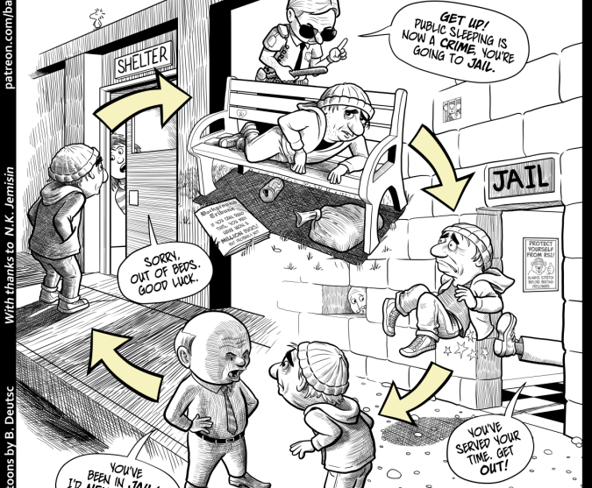

Slide 58
Key Take Aways
Keys of successful housing focused case management:
Trauma informed care
Person-centered approach
Structured and on-going housing service plans
Effective communication
Empowering self-determination and autonomy
Housing first
Rapport Building
Understanding the resources
Motivational interviewing
Understanding and educating clients on tenant rights

Slide 59
References
https://www.orgcode.com/blog/housing-based-case-management
https://blog.famcare.net/homeless-case-management-best-practices-you-must-know-about
https://nhchc.org/wp-content/uploads/2019/08/Pages-from-Organizing_Health_Services_book-1.pdf
https://www.huduser.gov/portal/periodicals/em/spring-summer-23/highlight2.html
https://ag.ny.gov/sites/default/files/tenants_rights.pdf
https://thesafecenterli.org/
https://housingfirst.marinhhs.org/housing-first
https://endhomelessness.org/resource/housing-first/#:~:text=Additionally%2C%20Housing%20First%20is%20based%20on%20the,in%20remaining%20housed%20and%20improving%20their%20life.&text=More%20extensive%20studies%20have%20been%20completed%20on,choice%2C%20and%20control%20in%20Housing%20First%20programs.
https://www.crisisprevention.com/blog/general/cpi-s-top-10-de-escalation-tips-revisited/
https://www.samhsa.gov/sites/default/files/nc-smart-goals-fact-sheet.pdf
https://ag.ny.gov/resources/individuals/civil-rights/sealing-your-criminal-record
https://eform.pandadoc.com/?eform=22823174-55b2-4f8f-b9e0-9d4824964667
https://www.huntingtonny.gov/filestorage/13751/16461/18802/18824/Susidized_Senior_Housing_(Issued_by_Suffolk_County).pdf
https://www.catholiccharities.cc/how-we-can-help/housing
https://www.unitedwayli.org/safe-home-seniors
https://www.familyfirsthomecompanions.com/long-island-senior-resources/
https://suffolkcountyny.gov/aging
https://aging.ny.gov/
https://www.licares.org/what-we-do/feed-long-island/s-o-s-supporting-our-seniors/
https://ocfs.ny.gov/programs/adult-svcs/ftha/map.php
https://www.fsl-li.org/find-help/senior-caregiver-services/
https://www.catholiccharities.cc/index.php?option=com_content&view=article&id=21&Itemid=119
https://opiny.org/residential-adults/

Slide 60
References
https://veterans.ny.gov/supportive-housing-hud-vash-program
https://thearborsassistedliving.com/veterans/?utm_source=Google&utm_medium=PPC&utm_campaign=HibuSearch&useYB=1,2,3,4,5,6
https://affordablehousingonline.com/
https://www.lihp.org/rentals.html
https://hcr.ny.gov/find-affordable-housing
https://www.lihp.org/babylonmtgarrears.html
https://www.lihp.org/BabylonTBRA.html
https://otda.ny.gov/programs/temporary-assistance/
https://www.ssa.gov/apply
https://otda.ny.gov/programs/ssp/
https://www.eoc-nassau.org/family-development-centers
https://eoc-suffolk.com/family-development/
https://www.hempsteadworks.com/
https://brookhaven.dressforsuccess.org/
https://www.health.ny.gov/health_care/medicaid/program/medicaid_health_homes/
https://opiny.org/residential-adults/
https://www.salvationarmyusa.org/usn/rehabilitation/
https://www.sailservices.org/supported-housing
https://oasas.ny.gov/support-services?f[0]=location_filter_term%3A321&page=0
https://www.youtube.com/watch?v=nM7tschT3R0

Slide 61
References
https://suffolkcountyny.gov/portals/3/Docs/Assisted%20Living%20Facilities%206-2019.pdf
https:/www.longbeachalp.com/medicaid-assisted-living-nassau-county/
https://www.unitedwayli.org/housing-opportunities-persons-aids-hopwa
https://optionscl.org/housing-related-services/
https://catholiccharities.cc/how-we-can-help/hiv-aids
https://tsli-hhb.org/programs/
https://www.spahousingli.org/
https://www.catholiccharities.cc/how-we-can-help/office-of-persons-with-disabilities
https://sus.org/our-services/veterans/
https://eoc-suffolk.com/supportive-services-veteran-families-long-island/
https://www.suffolkcountyny.gov/veterans/Housing
https://uvbh.org/residential-programs/
https://veteran.com/new-york-veterans-home-loans/
https://www.va.gov/housing-assistance/

Slide 62
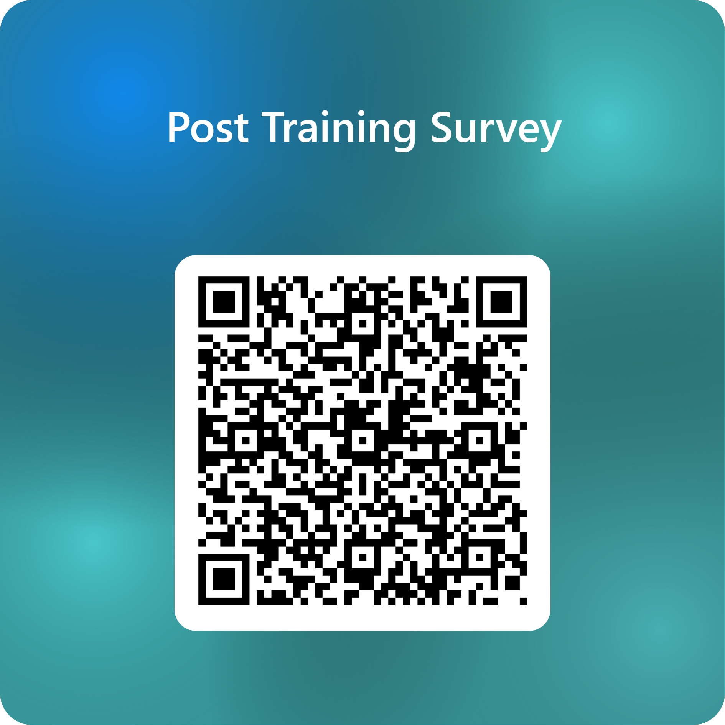
Presenter Information & Survey Link
Alexis Goglas, MSW
Long Island Coalition for the Homeless
Supervisor of Direct Support
Email: agoglas@addressthehomeless.org
Carrie Garcia
Long Island Coalition for the Homeless
CoC Training and Support Manager
Email: cgarcia@addressthehomeless.org
Jessica Labia, LMSW
Long Island Coalition for the Homeless
Director of Support Programs
Email: jlabia@addressthehomeless.org

