Slide 1

Engaging People with Lived Expertise
Enhancing Feedback Loops and Sharing Power

Slide 2
Presenters
Al Licata
CoC Planning
Terri Tupper
Community Support Specialist
Samantha Grimaldi
Street Outreach Specialist
Mike Giuffrida
CoC Planning

Slide 3
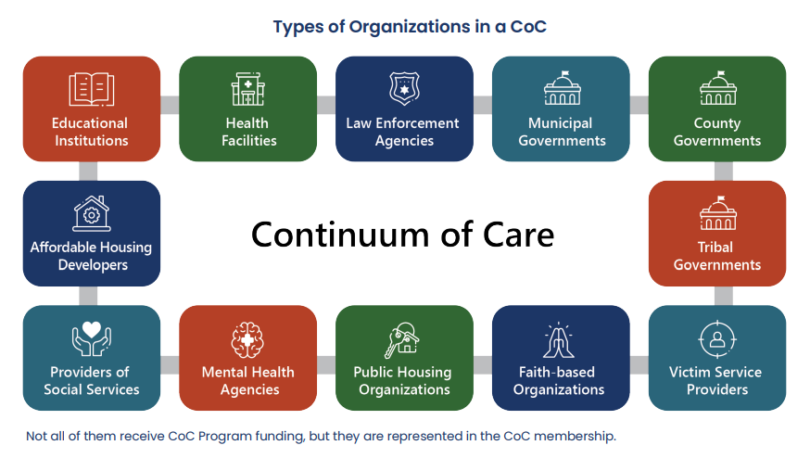
Who is currently at the table??
People with lived experience of homelessness and community members are also essential members of a CoC
also be CoC members
Notes:
Al

Slide 4
What do we mean by “lived expertise”
Lived expertise
Personal knowledge about the world gained through direct, first-hand involvement in everyday rather than through representations constructed by other people
-Oxford
Peer Specialist
A person who, by virtue of special knowledge, training, and experience, is uniquely able to inform, motivate, guide, and support persons in recovery from a mental health condition, diagnosis or major life disruption.
-NYS Certification
Notes:
Al

Slide 5

Why is it important for providers to engage people with lived expertise of homelessness?
People who have experience navigating the homeless response system have an up-close view of what is working and what is not
They can share relevant solutions that would work best for the people in their community that are more collaborative, innovative, creative, and accessible, particularly for persons often considered to be “hard to reach”
Policies and practices are developed with the full and direct participation of those most affected by them
https://files.hudexchange.info/resources/documents/COVID-19-Homeless-System-Response-Engaging-Individuals-with-Lived-Expertise.pdf
Notes:
Al

Slide 6
Charity vs. Justice
There is often a disconnect between non-profits and the people they serve.
Thinking about this work as striving for justice instead of providing charity brings us all onto the same level to collaborate towards a common goal.
Systemic injustice causes homelessness
Center empathy
Value life experiences: the solutions are there!
Notes:
Al, Samantha & Terri
Charity- charity inherently creates a stigma of inequality/ puts one party on a pedestal, charity also makes it seem like any amount of help is enough and the receiving party should be grateful of any help received, this perpetuates doing the bare minimum and feeling like an altruist.
Justice – acknowledges fault at the systemic not individual level for homelessness and brings equality and equity back to the table
Replacing justice with charity should be the goal. People experiencing homelessness are looking for justice and instead are given charity and expected to accept the minor charity an amends for their major injustice.

Slide 7
Benefits for people with lived expertise
Partnership in decision-making
Empowerment to create change
Personal growth
Leadership development
Peer support
Advocacy
Notes:
Samantha & Terri
Advocacy – gives your voice back, you can call these organizations as an individual needing help and they will tell you your SOL, but you call these same organizations as a worker of a CoC or fellow organization and all of a sudden your voice is heard, gives you your power back
Empowerment to create change -After being rejected & ignored by everyone; government, people, courts, non profits, having your opinion/voice be heard by an organization with the power to create the changes you tried to advocate for as just a PLE w/o an organization backing you
Personal Growth – Pathway to peer certification will help PLE’s help themselves and help others
Peer Support – unparrelled Empathy, Solidarity, instantaneous trust and understanding
*benefits can only be realized when risks are acknowledged and properly addressed, risks include re-traumtiziation, falling back into homelessness, not feeling heard etc.
Addressed by: reasonable accommodations for PLES, model in place to help PLE’s cope, proper copensations where falling back into homelessness is not a risk anymore

Slide 8

Benefits for homeless response system
Recognizing the humanity of those experiencing homelessness
Better community understanding of homelessness
Improving systems to more quickly and safely exit people from homelessness
Notes:
Samantha & Terri
1- The homeless population consists of societies most vulnerable(those w/ disabilities w/o family support & those w/ or w/o disability who have no family/support system), they’ve lost their voice & fallen through the cracks. Giving power back to those who know what it’s like to be voiceless & invisible.
2- People can’t escape homelessness because it is legalized (system sponsored) human trafficking, everyone is just one disaster away form homelessness(or a series of unfortunate events)
3- Becomes a full time job navigating the system before you know it 6 months have gone by you’ve made 1,000 phone calls and reached nothing but a dead end
Urgency – organizations not working on the timeframe that matches the need

Slide 9

Providers:
How has engaging people with lived experience impacted your work?
Notes:
Samantha & Al

Slide 10
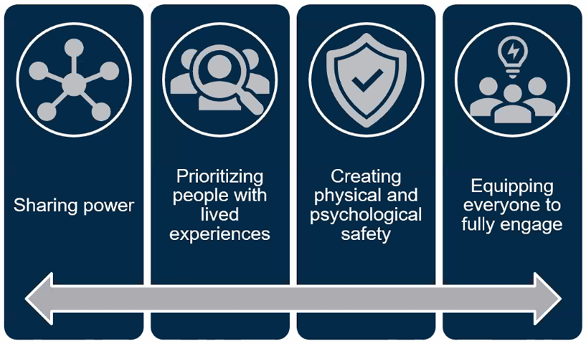
Authentic Engagement
www.casey.org
Notes:
Mike

Slide 11
How We Get There
Compensation
Making Room
Power Sharing
(voting, decision-making)
Hiring
Building relationships & trust
What has success looked like in your program?
Notes:
Mike

Slide 12
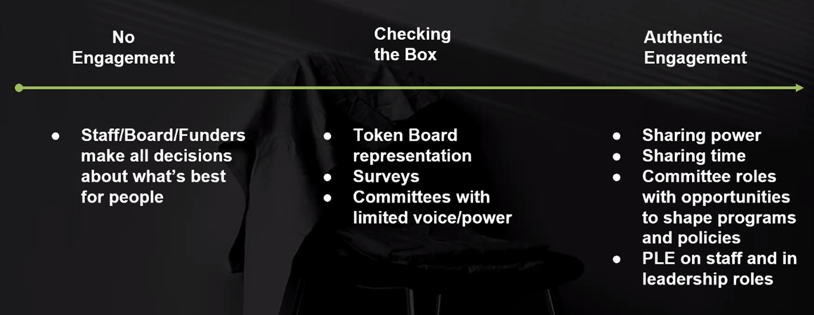
Progress Towards Authentic Engagement
Notes:
Mike

Slide 13
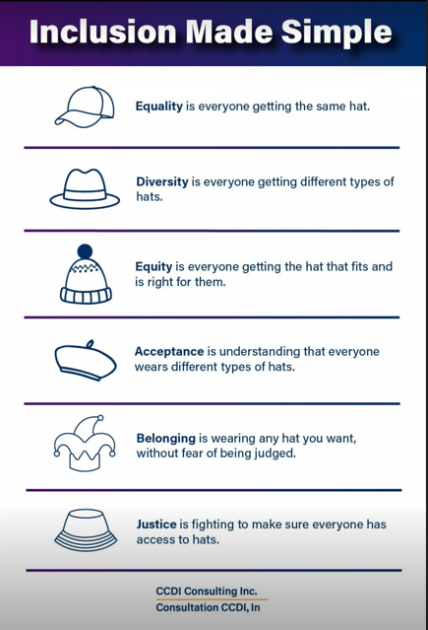
Importance of Inclusion & Belonging
Notes:
Mike

Slide 14
Trust and Mutual Respect
Build Rapport & trust
Follow through
Share power and time
Acknowledging system failures
Notes:
Mike & Terri
Acknowledge the person’s whole situation and how engaging might impact them
Understanding people and aligning the “why”

Slide 15

Ways to engage: A variety of approaches
Listening sessions
Advisor or membership role on Community Action Board
Lived experience advisory and/or working groups
Invitations and outreach to be a member of CoC Board
Hiring at all levels (not just direct care!)
Notes:
Al & Samantha
Direct care work for PLE may not be sustainable

Slide 16
Racial Justice & Equity
Lead with race equity and social justice
Develop specific equity core beliefs and goals
Ensure accountability to uphold these values
Understand who is accessing your system and make sure that those groups are fully represented in decision-making
Be willing to give up control and get uncomfortable
Recent Initiatives
Diversity Equity & Inclusion training series
Restructure of the governance board
Notes:
Mike
Lead with race equity and social justice
ensuring the same level of input, decision-making, and access to organizational resources.
Understand who is accessing your system and make sure that those groups are fully represented in all aspects of decision-making.
For example, if most persons experiencing homelessness in your community are also Black, then your Continuum of Care (CoC) Board and governance structure should mirror that.
Understand racial trauma and the racial disparities that exist within your homelessness response system. Institute a “Racial Equity Team” that will develop specific equity core beliefs and goals that can be integrated into all other CoC goals. Ensure that there are policies and procedures in place for accountability to uphold these values.
Be willing to give up control and get uncomfortable using best practices and strategies for engaging persons with lived experience. Promoting the power of people with lived expertise requires an understanding of the historical missteps that CoC leaders have taken by taking away the power from the people accessing their services.
Ensure that people with lived expertise are included in the process at the genesis, be as transparent as possible, and build up a collaborative relationship with individuals with lived expertise while allowing their views or experiences to lead the process.
Ensure your system authentically engages by creating space for people with lived expertise to have voting, hiring, and decision-making power.
Ensure people with lived expertise are compensated for their time and contributions. This includes providing meals, transportation, Wifi, and other technology that allows for full participation—access to technology is critical for participation during COVID-19.
Devote the necessary resources to make the programming successful (i.e., budget, staff, time, space). Do the personal and professional development work. Staff and leaders must intentionally work on identifying the ways in which their own implicit racial bias has done harm and do the work necessary to allow for more equitable and trauma-informed approaches.

Slide 17

Going outside your existing network
Example from recruitment onto LICH team
Notes:
Terri & Samantha
Tell the story of how we met
Sam→ follow HUD funding, found coalition, called helpline for help, Terri picked up, (terri take over from there)

Slide 18
Accommodations & Access
Emphasize and value lived experience
Modify job descriptions & requirements
Acknowledge trauma past & present
Onboarding & job support
Provide flexibility in the way things are done
Consider pay rates & opportunities for professional development
  Peer certification can help qualify for hire pay rates while providing coping skills to prevent re-traumitization
Notes:
Terri & Samantha
There are some things you can only learn through experience.
Need for hybrid positions for PLE’s to accommodate physical disabilities and/or PTSD/cPTSD
Terri-s reasonable accommodations
Different does not mean worse! Be accepting of different methods of getting things done. In a lot of ways different for PLE’s will lead to more effective and efficient measures of getting the same work done

Slide 19
Resources & Compensation
Devote the necessary resources to make the programming successful
  Budget
  Staff
  Time
  Space
Compensate people for their time & expertise at fair rate
  Comparable to other employees
Consider method of providing compensation
Notes:
Al

Slide 20
Common missteps
Tokenization
One-off collaborations such as surveys or focus groups
Lack of transparency
Lack of knowledge sharing
No real power to make changes / Feedback never acted upon
Speed over meaningful engagement
Not enough support to ensure participation
Inaccessible meeting spaces and/or times
Only recruiting for direct care staff, no involvement in leadership or decision making
Notes:
Al & Terri
Some potential missteps to monitor for include not sharing decision-making power with people with lived expertise, information hoarding, or relying on one-off collaborations such as focus groups and surveys.

Slide 21
NY-603 CoC Lived Experience Advisory: Principles
Creating liberated spaces
Group power sharing
Valuing feedback and time
Consensus
Notes:
Al & Terri

Slide 22
CoC Lived Experience Advisory Successes
National Low Income Housing Coalition Advocacy Day
CoC Monitoring Committee nominations
Notes:
Al, Terri, Samantha

Slide 23
Meaningful Engagement for Community Planning
Centering voices and experiences of people with lived experience
Considering them to be the most valid and informed
Sharing and relinquishing power to people with lived experience
Inclusion in all decision-making processes
Policy
Funding
Program design and implementation
And more!
Engagement should take place before decisions are made
CoCs, funding recipients of CoC, ESG, & ESG-CV funding
Notes:
Mike

Slide 24
HUD and local priorities for engaging people with lived experience
HUD Considerations
2022 Ranking Criteria
Active CoC participation
Professional development & employment opportunities
Routinely gathering feedback and addressing challenges
Involvement on staff / recruitment strategy
Involvement in program design
Involvement in program feedback
Involvement in staff training
Notes:
Mike

Slide 25
How to follow up with us
Al Licata: alicata@addressthehomeless.org
Terri Tupper: ttupper@addressthehomeless.org
Samantha Grimaldi: sgrimaldi@addressthehomeless.org
Mike Giuffrida: mgiuffrida@addressthehomeless.org

