Slide 1
CoC Orientation
Thanh Pham, MPH
Community Outreach and Support Specialist

Slide 2
Welcome!
Let’s work together to end homelessness on Long Island

Slide 3
What is a CoC?
Acronym CoC – Continuum of Care
A local planning body that coordinates housing and services for people experiencing homelessness in a specific region

Slide 4
How many CoC’s are there?
There can only be 1 CoC within a specific geography
There are >400 CoCs in the US

Slide 5
What does the lead agency do?
The lead agency is responsible for managing the Homeless Management Information System Database, submit its annual application for funding to HUD, and monitor CoC funded program performance
Responsibilities –
The lead serves as the liaison to the Federal Government and Local Entities
The lead manage the database system in which clients are entered in
The lead assists providers with the Department of Housing and Urban Development (HUD) application process and provides training/support where needed
Long Island Coalition for the Homeless (LICH) is the lead agency to the CoC
The CoC oversees both Nassau and Suffolk Counties on Long Island

Slide 6
Who makes up the CoC?
Housing Providers
Case Managers
Shelter Workers
Street Outreach Workers
Administrative/Data
Community Based Organizations
Community Members
Advocates
Persons with lived experiences
Local municipalities (i.e. libraries, schools, etc.)
Public Housing Authorities (PHA’s)
Local Government Entities
Department of Social Services
Legislators
Faith-Based Organizations

Slide 7
CoC Funded Programs
Suburban Housing

Slide 8
How do I join/sign up?
Visit our website:
Lihomeless.org
Former meeting minutes, committee information, CoC meeting list, etc.
Email Thanh, Community Outreach & Support Specialist – tpham@addressthehomeless.org
Join the CoC List-serv – receive updates within our region, resources, invitation to our committee meetings, funding opportunities, connect with others who engage or directly work with people experiencing homelessness
If you would like to present on behalf of your agency (services/resources/etc.), please contact Thanh
The CoC Business Meeting is open to all
There are no fees associated with joining the CoC and everyone who is a part of the CoC plays an important role in addressing homelessness on Long Island
Other Subcommittees – CES Case Conferencing Group, Street Outreach Committee, CE Steering Committee, etc.

Slide 9
CoC Organizational Chart
CoC Governance Board
CoC Business Meeting
Subcommittees

Slide 10
CoC Business Meeting (Open Meeting)
General Body Meeting
We meet monthly (via Zoom/Phone)
Every 3rd Friday of the month (unless indicated otherwise) from 9:00AM-10:15AM
Minutes are sent out via email and put on our CoC Website: lihomeless.org
Meeting Agenda
Funding Updates
Local / State / Federal
Technical Assistance Updates
Shelter Updates
Department of Social Services
Housing Updates
Coordinated Entry Teams (LICH CES AND TSCLI CES)
Data Updates
HMIS Team
Events/Trainings
Resource Sharing + Provider Updates
Presentations from other providers (services, advocacy/policy, resources)

Slide 11
CoC Governance Board Meeting (Closed Meeting)
Funding Updates
Local
Voting
Policy Implementation or Changes
Assessments/Prioritization, etc.
Operational Changes
Meeting member slates – nomination process

Slide 12
Subcommittees
CE Steering Committee
Process for housing prioritization (and who will be served) is determined by this committee and the Governance Board
CES Case Conferencing
Discuss high barrier cases (chronic shelter clients, street outreach, rapid rehousing programs)
Trouble-shoot/problem-solve
Resource sharing
Street Outreach Committee
Updates with street outreach workers/providers/people that engage with people living on the street
Resource sharing
Identify new/highly populated areas
Committee collaboration
Point in Time (PIT Count)

Slide 13
Homeless System on LI

Slide 14
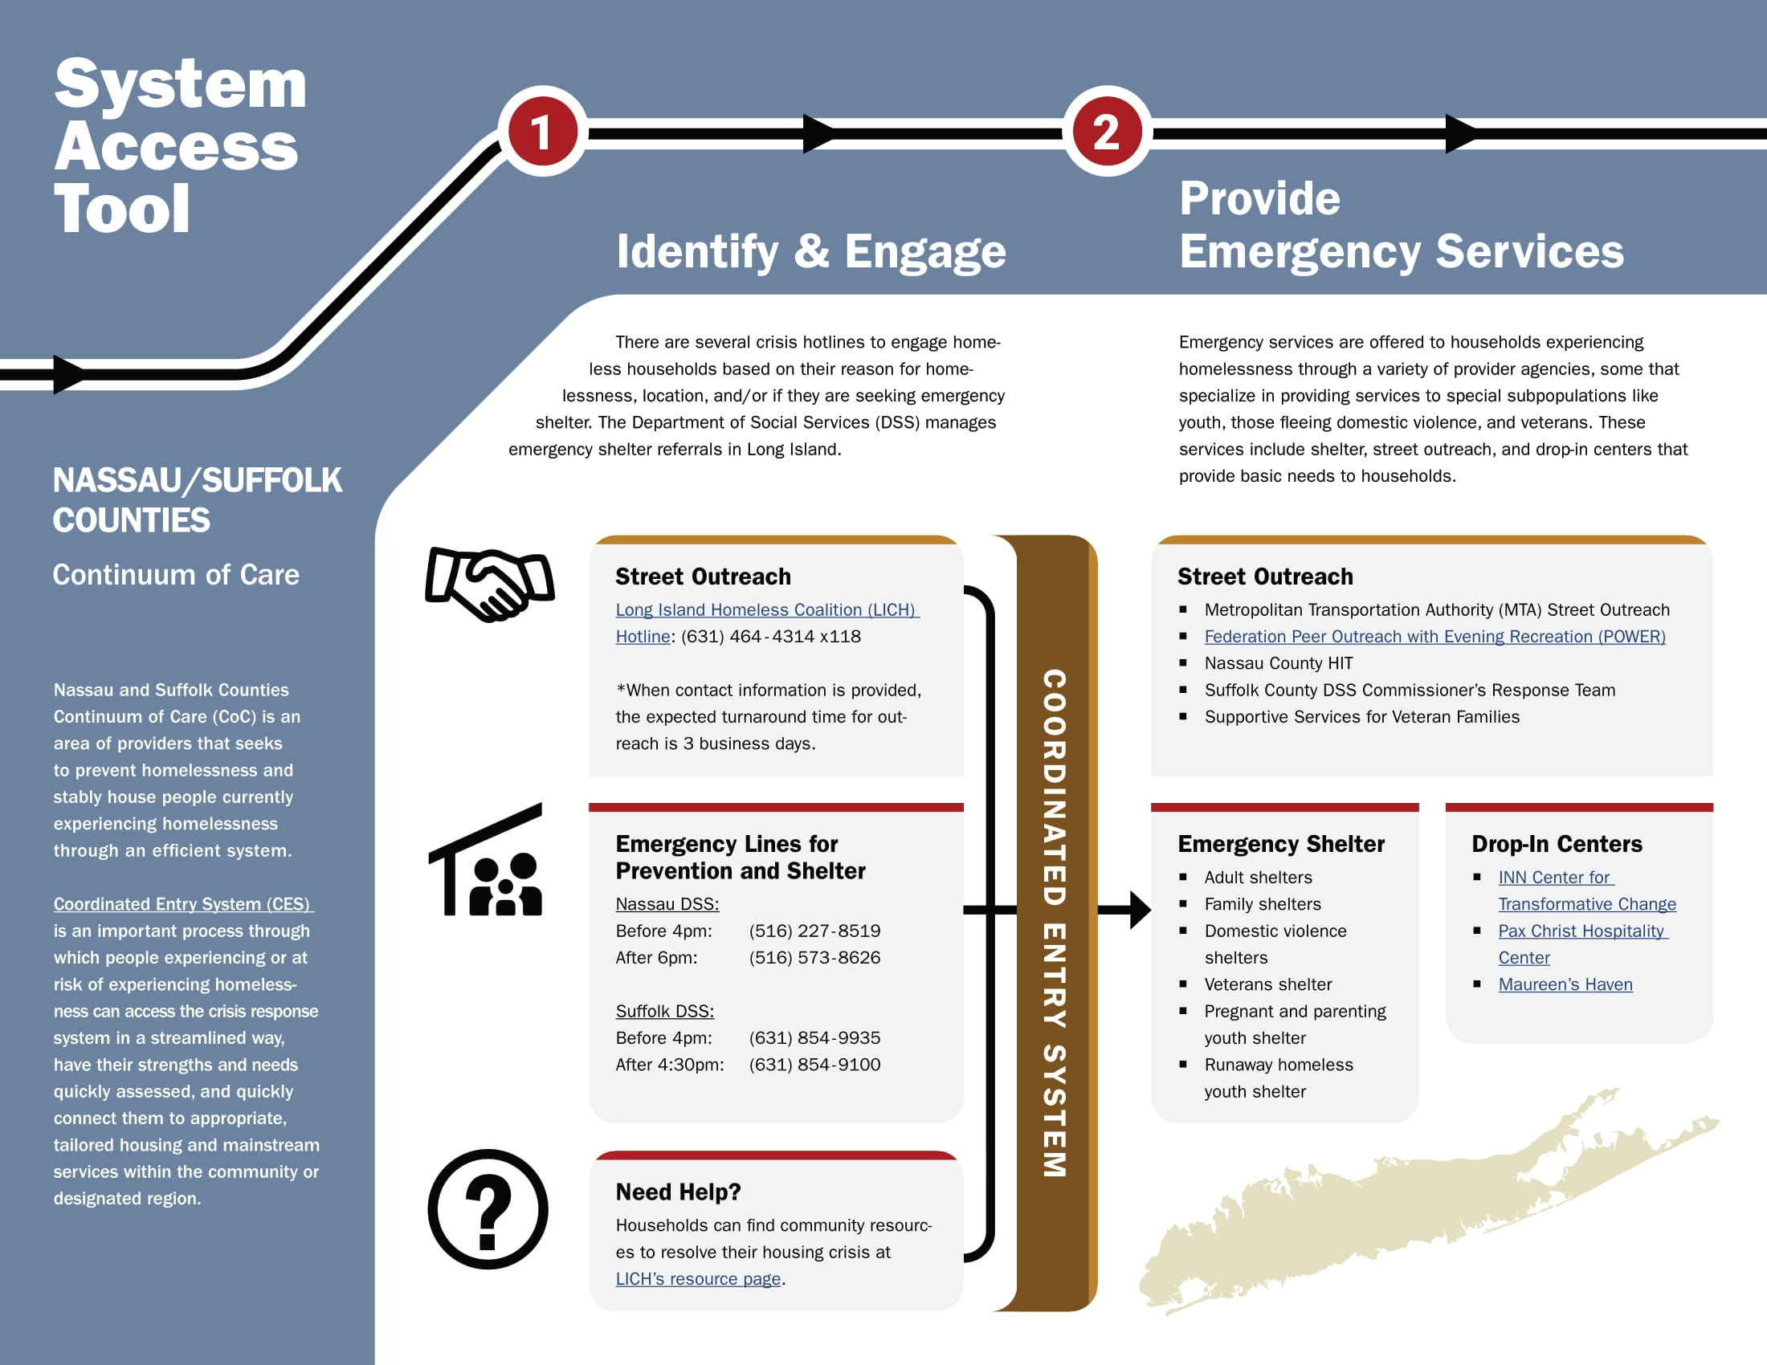
First – Identify and Engage Second – Connection to Emergency Services

Slide 15
Third – Access to Housing and Services Fourth – Provide Housing and Services

