Slide 1
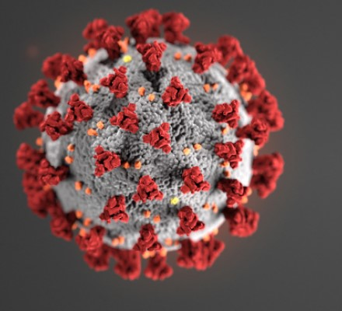
Addressing vaccine hesitancy
Street outreach/Homeless Service providers
Community leaders
Street outreach Committee meeting
April 13, 2021
9:30AM-10:30AM

Slide 2
Before we begin
Name and Agency – Using the chat box (Feel free to introduce yourself!)
We will begin shortly (approx. 3-4 minutes)
Session will be recorded and posted as well as any materials
Please mute mics and enter questions in the chat. Depending on the questions, may be answered during the discussion or at the very end

Slide 3
Agenda
Brief Recap of The Vaccine Rollout on LI – Greta (2 minutes)
Purpose of this Meeting (2 minutes)
Brief Introduction of our Speakers (2 minutes)
Discussion Points/Presentation (45 minutes)
Ending Thoughts (5 minutes)

Slide 4
Vaccine rollout work
Collaboration with Northwell Health
Identified 7 Distribution Sites across LI for vaccine rollout
Update 4/13
  First rollout event – April 16th (Friday) at Long Island Coalition for the Homeless (Amityville)
    Pfizer Vaccine will be administered instead of J&J
    Approx. 50 shots will be available at this location
    Target Audience: people experiencing homelessness (people living on the street and people living in shelter), staff members (limited), and community members (standby list)
  Registration form: Due Wednesday at 5PM

Slide 5
Purpose of meeting
To provide a better understanding of how staff/people that conduct outreach can educate the target population
To address and better understand the communities’ needs
To utilize what is learned from today to start and continue the conversations with people living on the street – to inform that there are opportunities to get vaccinated if clients choose to do so

Slide 6
Introduction of speakers
Speakers will provide insight and address any concerns related to vaccine hesitancy and outreach methods

Slide 7
Frequently asked questions/statements
(health perspective)
The side effects of the COVID-19 Vaccine are Dangerous
Can COVID-19 Vaccines cause you to get very sick?
Researchers rushed the development of the COVID-19 vaccine, so its effectiveness and safety cannot be trusted
There weren’t enough clinical trial participants to declare the vaccines safe
After getting a covid-19 vaccine, will I test positive for covid-19 on a viral test?
Will a covid-19 vaccination protect me from getting sick with covid-19?
If I have already had covid-19 and recovered, do I still need to get vaccinated with a covid-19 vaccine?
Can I be vaccinated against COVID-19 if I have an underlying medical condition?
How do we know if covid-19 vaccines are safe?
Could they cause long-term problems?
Should you get the vaccine if you are pregnant or breastfeeding?

Slide 8
Pfizer, moderna
Effectiveness
Shots Needed
Type of Vaccine
Storage

Slide 9
Insight from community leaders
Migrant worker population
  Majority are Hispanic and may be undocumented
Having conversations with community members
  Seeing someone they trust who received the vaccine and speaking on their experience(s)
  Building trust and confidence
Building partnerships between Homeless Service Providers, Community Leaders, Health Professionals, and other Community-based organizations
  To collaborate with one another - to provide transportation to vaccine site, help educate, help inform of the opportunities, help address any other barriers (language, cultural, religious, spiritual, medical mistrust, education materials, etc.)
  Building trust and confidence

Slide 10
Ending thoughts/wrap up
Questions?
All materials will be sent out
[1] Recording
[2] PowerPoint Presentation
[3] 1 page document summary to use for outreach/educational purposes
[4] Contact information of speakers

Slide 11
References
[1] https://www.aamc.org/news-insights/6-myths-about-covid-19-vaccines-debunked
[2] https://www.hopkinsmedicine.org/health/conditions-and-diseases/coronavirus/covid-19-vaccines-myth-versus-fact
[3] https://www.aafp.org/dam/AAFP/documents/patient_care/public_health/COVID19-Vaccine-Myths.pdf
[4] https://www.cdc.gov/coronavirus/2019-ncov/vaccines/facts.html
[5] https://www.ama-assn.org/delivering-care/public-health/covid-19-vaccines-patients-frequently-asked-questions
[6] https://lancastergeneralhealth.org/health-hub-home/2021/february/addressing-vaccine-hesitancy-among-people-of-color

