Slide 1
Gender Equity and lgbtqia+ rights
CoC Training
Notes:
**Biden admin

Slide 2
Land Acknowledgement
The Long Island Continuum of Care (CoC) occupies the native homelands of the following tribes which were stolen through genocide, forced removal, and unfair treaties.
Munsee Lenape
Lekawe
Matinecock
Merrick
Massapequas
Nissaquogue
Secatogue
Setalcott
Unkechaug
Corchaug
Shinnecock
Montaukett
Mannansett
The CoC acknowledges the contributions, past and present, of the indigenous peoples who are the original caretakers of this land.
1: Native Land Digital

Slide 3
Purpose of sharing Pronouns
Giving everyone the opportunity to self-identify
Creating a welcoming space for people of all genders
Avoiding assumptions

Slide 4
Group Agreements
Intellectual humility
Be willing to sit with discomfort. Discomfort is necessary for growth!
Notice your reactions to the content – whether they be defensive, dismissive, positive, etc.

Slide 5
Overview
Positionality
Key Concepts & Definitions
Pronouns & Language
Intersection LGBTQ+ identity and homelessness
Fair Housing & LGBTQ+ people

Slide 6
Positionality
How we experience and understand the world is influenced by social and spatial positions that we occupy
Social: gender, race, class, ability
Spatial: time & place

Slide 7
Positionality impacts:
How you interpret the world around you
How you view and respond to power differentials
How you interact with other people
All of our decisions are impacted by our positionality!

Slide 8
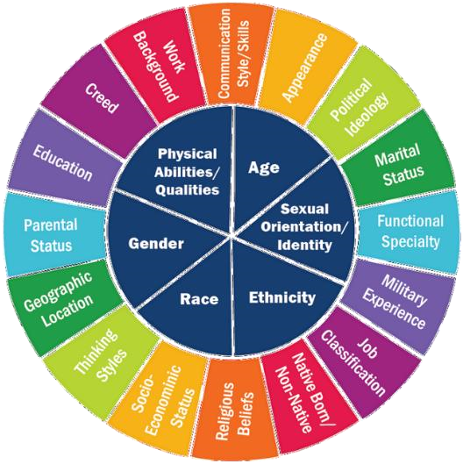
What is your positionality?
Type some of your thoughts in the chat if you wish!

Slide 9
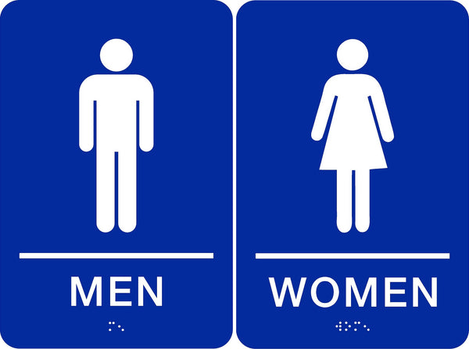

Positionality Exercise
What do you think when you see the following?

Slide 10
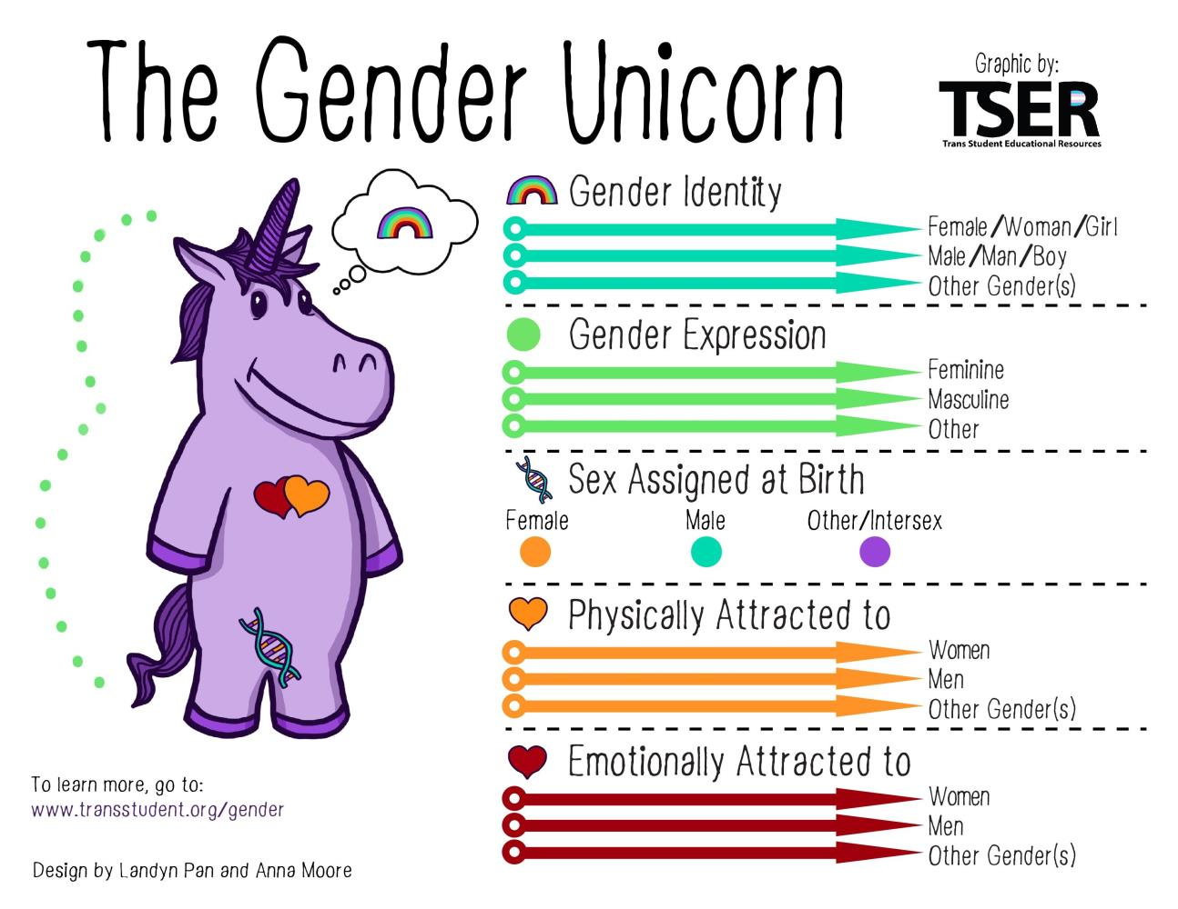

LGBTQia+ Identity

Slide 11
What is sex?
Sex refers to the different biological characteristics associated with reproduction such as:
  Chromosomes
  Hormones
  Reproductive organs
Intersex refers to having a mix of characteristics typically associated with males and females in the categories above
  Examples: chromosome combinations such as XXY, mix of secondary sex characteristics
  Intersex people make-up between 1-2% of the population [2]
2: Blackless et al 2000, How sexually dimorphic are we?

Slide 12
What is Gender?
Gender: socially constructed roles, behaviors, and actions people take on, often in relation to expectations of masculinity or femininity [3]
Gender identity: a person’s deeply felt, internal and individual experience of gender, which may or may not correspond to the person’s physiology or designated sex at birth
3: Schnebly 2022, Biological Sex and Gender in the United States

Slide 13
Gender Terms
Assigned Sex/Gender at Birth: Presumed sex and/or gender usually based on external anatomy, often determined by medical professionals and reflected on legal documents
Cisgender: Someone who identifies with their sex assigned at birth
Transgender: Someone who does not identify with their sex assigned at birth.
Nonbinary: An umbrella term for gender identities that can’t be exclusively categorized as man or woman.
Two-spirit: Two-spirit generally refers to a gender role believed to be a common, acknowledged, accepted, and praised gender classification among most First Nation communities, dating back centuries. Each First Nation tribe has its own understanding and meaning of what it means to be two-spirit, so this term can have many definitions.
[4] Healthline, 68 Terms that Describe Gender Expression

Slide 14
Gender expression Terms
Androgynous: Gender presentation that’s gender-neutral or has both masculine and feminine characteristics.
Femme Presenting: This describes people who have a gender expression or presentation that they or others categorize as feminine.
Gender Nonconforming (GNC): This describe people with a gender expression or presentation that’s different from cultural or social stereotypes associated with the person’s perceived or assigned gender or sex.
Masc Presenting: This describes people who have a gender expression or presentation that they or others categorize as masculine.
[4] Healthline, 68 Terms that Describe Gender Expression

Slide 15
Things to remember about Transgender Identities
Transgender is an umbrella term: Not every trans person expresses their gender the same way
Trans is more than male and female
Physical transition is not needed for someone to be transgender
Changes to legal documents to reflect gender identity is difficult and often inaccessible
It is not someone’s responsibility to educate you about their gender
You do not need to understand somebody’s gender or gender expression to respect them!

Slide 16
What is Sexual Orientation?
Sexual orientation: An enduring emotional, romantic, or sexual attraction to other people. Individual’s sexual orientation is often described as gay, lesbian, bisexual, heterosexual/straight, queer, or asexual
Sexual orientation is independent of gender identity
But sexual orientation is often defined in relation to gender
Romantic and sexual orientation are not always aligned
[5] HUD LGBTIA+ Fair Housing Toolkit

Slide 18
LGBTQIA+
Lesbian
Gay
Bisexual
Transgender
Queer/questioning
Intersex
Asexual
Which terms describe sex?
Which terms describe gender?
Which terms describe sexual orientation?
Why do you think these terms are grouped together under one acronym?

Slide 19
Behaviors to avoid
Invasive questions about
  Surgery, hormones, & body
  HIV status
  Relationships with partners, family, & children
Why are these behaviors to be avoided?
  Asking about someone’s body in relation to their gender is usually not relevant at best, and dehumanizing at worst
  People have the right to keep their medical information private
  Asking questions about an LGBTQIA+ person’s relationships that you would not ask if they did not hold that identity can be harmful and alienating
Do not expect LGBTQIA+ individuals to educate you on their community. While some individuals may be happy to speak about their perspectives, others are not.

Slide 20
Language & Pronouns
Respecting transgender people
Creating an inclusive and affirming environment

Slide 21
Importance of Inclusive & Affirming Language
Definitions
Context
Misgendering: using the incorrect pronouns for someone or using gendered terms for them that does not align with their identity
Deadnaming: using a name for someone that they no longer identify with
Transgender people are at higher risk for depression, suicide, and self-harm compared to their cisgender peers
Studies show that youth that are affirmed by use of their pronouns and chosen name are at lower risk for suicidal behavior and depression
Misgendering is a microaggression. Repeated misgendering has a cumulative affect that can make someone feel unwelcome and/or unsafe.
7: Child Trends 2018, Research shows risk of misgendering transgender youth

Slide 22
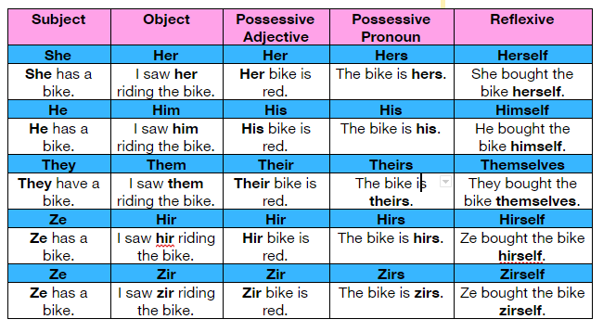
Pronouns
Pronouns are not “preferred” but instead are required for respectful communication
Make a point to ask everyone you meet what their pronouns are.
Gender expression is not an indication of one’s pronouns.
[7] UC Santa Barbara Resource Center for Sexual & Gender Diversity, Pronouns 101

Slide 23
Inclusive Language
Gender comes up often in language, but it does not have to!
Avoid gendered terms whenever speaking about a group
  Folks, y’all, everyone, etc.
Use gender neutral language for people whose gender is unknown to you
  Spouse, partner
  Police officer, mail carrier
  Gender neutral honorifics
Verbal Communication
To avoid assuming gender in conversation:
Instead of: “How may I help you, sir?”
Say: “How may I help you?”
Instead of: “He is here for his appointment.”
Say: “The applicant is here for their appointment.”’
Written communication
Gender neutral titles and honorifics:
  Ind. (abbreviation of individual)
  M.
  Mx. (“mix” or “mux”)
  Pr. (“per”, for person)
https://www.hudexchange.info/programs/fair-housing/lgbtqia-fair-housing-toolkit/inclusive-communication/pronouns-titles-and-honorifics/

Slide 24
Affirming language & updated terminology
Inappropriate/outdated terms | Recommended language
Transexual, “a transgender” | Transgender/trans, transgender person
Sex-change operation, cross-sex hormone therapy | Gender affirming medical care
Hermaphrodite | Intersex person
Legal name | Chosen name, name used
Preferred pronouns | Pronouns, correct pronouns
Sexual preference/lifestyle | Sexual orientation, orientation
Homosexual | Gay, lesbian, gay person
LGBTQ+ lifestyle | LGBTQ+ people and their lives
“a they” (as a noun) | Person who uses they/them pronouns, non-binary person
Always use person-centric language!
Recognize that many terms used here are adjectives.

Slide 25
What to do if you make a mistake
If you accidentally misgender someone or use their deadname you should:
Apologize once
Correct the mistake
Move on
Avoid: Explanatory and self-deprecating apologies, centering yourself in the apology
It is best to acknowledge and correct your mistake in the moment.
Purposefully misgendering someone is an act of violence, indicating a lack of respect for the person.
Example scenario:
Person A: What have you two been up to?
Person B: C and I just picked up some supplies and she carried all the boxes!
Person C: My pronouns are they/them.
Bad apology: “Wow! I am so, so sorry. I am the worst with this stuff and have such a hard time using they or them to refer to someone. It just seems unnatural to me.”
Good apology: “Yes, sorry, I meant they”

Slide 26
Calling out/in Mistakes
Correcting misgendering or non-inclusive language of others is an important part of making LGTBQ+ co-workers and clients feel welcome
Corrections are best done in the moment, where the person has the chance to apologize and amend their behavior
Corrections are important even when the person who was misgendered is not present. It reinforces the idea that these mistakes are not welcome and can help the person who made the mistake learn.
Language to address mistakes can be short and simple:
  “Actually, D uses he/him pronouns.”
  “She doesn’t use that name anymore and goes by E.”
  “You should say everyone instead of ‘ladies and gentlemen’. Not everyone here is a man or woman.”

Slide 27
Understanding Trans Experiences
Be sure to communicate with clients or participants about which name and pronouns they would like used
  This may depend on context!
Make sure to note difference between name on government documents and name the client goes by on their records
Changing documents and legal records to match someone’s current name and gender identity is not easy
Trans people are less likely to have access to health care. Just because they have not medically transitioned does not make them any less trans.
Trans people face systematic exclusion from many parts of public life. Gendered spaces of any kind can be difficult to navigate.

Slide 28
Privilege
As of 6/2023 there are 491 anti-LGBTQ bills in the U.S. [6]
^{Gender expression in public}
^{Health care access}
^{Free speech}
^{Restroom access}
^{Education}
^{Sports}
Example: Cis gender privilege means not having to think about safety around your gender in public
What are examples are some examples of privilege you can think of?
[8] ACLU: Legislative Attacks on LGBTQ Rights

Slide 29
Intersectionality
“Intersectionality is a lens through which you can see where power comes and collides, where it interlocks and intersects. It’s not simply that there’s a race problem here, a gender problem here, and a class or LBGTQ problem there. Many times that framework erases what happens to people who are subject to all of these things.”
Kimberlé Crenshaw
[9] Columbia Law School, Kimberlé Crenshaw on Intersectionality, More than Two Decades Later

Slide 30
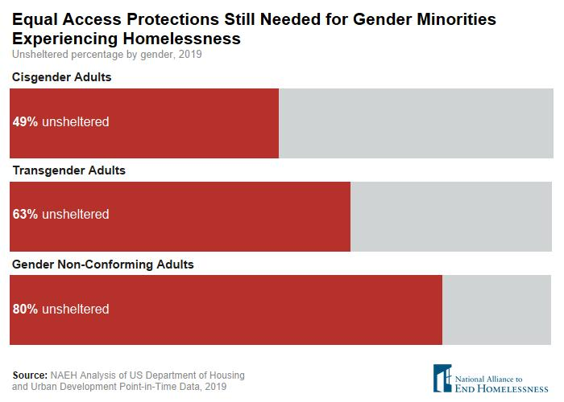
Intersections of Trans Identity & Homelessness
BIPOC people have a higher risk of experiencing homelessness when compared to their non-BIPOC counterparts
Transgender people are more likely to be unsheltered than their cisgender peers
BIPOC LGBTQ people are at even higher risk of homelessness
  Housing, workplace discrimination, and health care discrimination are also more likely and contribute to homelessness
[10] National Alliance to End Homelessness, Trans and Gender Non-Conforming Homelessness

Slide 31
Vulnerability of LGBTQ+ People
In a nationally representative survey conducted by the Williams Institute between 2016 and 2019, researchers found that 17 percent of LGBTQIA+ adults reported they experienced homelessness at some point in their lifetime, more than twice than the rate of the general population [11]
  BIPOC youth have an 83% higher risk of experiencing homelessness when compared to their non-BIPOC counterparts, with BIPOC LGBTQ+ youth at even higher risk of homelessness
  One in five transgender individuals have experienced homelessness at some point in their lives. [12]
Trans people are vulnerable to victimization based on their identity In 2023, 12 trans and gender non-conforming people have been murdered in the US. 75% were black and 83% were trans feminine. [13]
  38 were murdered in 2022
Trans people are more likely to have interactions with the criminal justice system. As homelessness becomes more criminalized, trans people are at high risk for adverse outcomes.
[11] Williams Institute 2022, Homelessness Among LGBT Adults in the US
[12] TransEquality.org, Housing and Homelessness
[13] Human Rights Campaign, Fatal Violence Against Transgender and Nonbinary Community

Slide 32
Housing service Access
Barriers
Solutions
Gender specific programs and facilities
Intake procedures that do not adequately capture experiences, or ask inappropriate & intrusive questions
Denial of placement that matches gender identity or inappropriate placement
Lack of culturally competent services
Increase availability of programs that are not segregated by gender
Intake forms that ask for chosen name, pronouns, and self-identification of gender. No burden of proof for gender identity.
Compliance with the Equal Access Rule
Programs designed in collaboration with LGBTQ+ people

Slide 33
Protections
Fair Housing Act
HUD’s Equal Access Rule
Bostock v. Clayton County & Executive Order 13988
Actual or perceived identities

Slide 34
Protected Identity designations
Actual identity
the way someone describes themselves in regards to protected categories such as race, ethnicity, gender, sexual orientation, etc.
Perceived identity
the understanding of someone else’s identity in regards to protected categories, often based on limited information and/or stereotyping

Slide 35
Fair Housing Act
The Fair Housing Act — This law prohibits housing discrimination because of race, color, religion, national origin, sex (including sexual orientation and gender identity), disability, and familial status (families with children under 18, including pregnancy and seeking legal custody) when renting or buying a home, getting a mortgage, seeking housing assistance, and other housing activities in both public and private housing.
Discrimination of any landlord or housing provider against any persons because of their actual or perceived sexual orientation or gender identity is prohibited
[5] HUD LGBTIA+ Fair Housing Toolkit

Slide 36
Practices to ensure compliance
Affirmative marketing
Standard screening and selection process applied consistently
Reasonable accommodations
Ensuring practices do not have inequitable impacts
[5] HUD LGBTIA+ Fair Housing Toolkit

Slide 37
Equal access rule (HUD Programs)
HUD’s Equal Access Rule —short-hand for 3 requiring that individuals have equal access to all HUD programs, including HUD-funded or HUD-insured housing, and HUD-funded temporary/emergency shelters, regardless of actual or perceived sexual orientation, gender identity, or marital status. [1]
HUD-funded homeless providers must place clients in a shelter or facility that corresponds to the gender with which the person identifies.
Providers must also ensure that their policies do not isolate or segregate clients based upon gender identity. Health and safety concerns must be taken into consideration.
[5] HUD LGBTIA+ Fair Housing Toolkit
Notes:
HUD-assisted programs include, but are not limited to:
Emergency Solutions Grant (ESG)
HUD Continuum of Care Program (CoC)
Housing Opportunities for Persons with Aids Program (HOPWA)
Community Development Block Grant (CDBG)
HOME Program
National Housing Trust Fund
HOME American Rescue Plan Program (HOME-ARP)
Other programs in HUD’s Office of Community Planning and Development (CPD)

Slide 38
Equal access Rule in Practice
Determine eligibility regardless of a person’s sexual orientation, gender identity, or marital status
Access facilities aligned with gender identity (includes accommodations with shared bathing facilities)
No burden of documentation, intrusive questioning, physical evidence shall be required
[5] HUD LGBTIA+ Fair Housing Toolkit

Slide 39
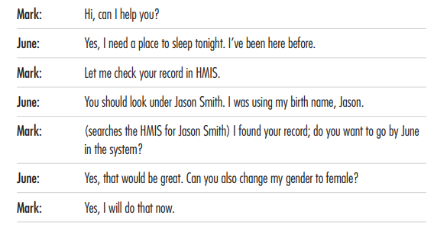
Training Scenario
[14]: Endhomelessness.org, Equal Access Expectations Training Scenarios

Slide 40
Other Rulings
Bostock v. Clayton County — Supreme Court decision that interpreted “sex” discrimination in Title VII of the Civil Rights Act of 1964, a law similar in text and purpose to the Fair Housing Act, to include sexual orientation and gender identity.
Executive Order 13988 Preventing and Combating Discrimination on the Basis of Gender Identity or Sexual Orientation — Directs all federal agencies to review all agency actions taken under federal statutes that prohibit sex discrimination and fully enforce those statutes to combat discrimination on the basis of sexual orientation and gender identity, consistent with Bostock.
[5] HUD LGBTIA+ Fair Housing Toolkit

Slide 41
What discrimination can look like
Refusal to rent or show housing
Steering
Unequal terms & conditions
Hostile environment harassment
Quid pro quo harassment
Notes:
19% of transgender individuals had been refused a home or apartment. 11% percent had been evicted.

Slide 42
Reporting Housing discrimination
File a complaint with HUD if you believe you have experienced (or are about to experience) housing discrimination
  Contact HUD's Office of Fair Housing and Equal Opportunity or call (800) 669-9777
  Visit HUD's File a Complaint webpage to file a complaint online
File a complaint with a state or local fair housing public agency
Fair housing act: complaints must be filed within ONE YEAR of the last date of the alleged discrimination
Any form of retaliation is prohibited by the Fair Housing Act
[15] HUD Office of Fair Housing and Equal Opportunity
[16] HUD, Report Housing Discrimination
Notes:
Respondent’s obligations under fair housing act
https://www.hud.gov/program_offices/fair_housing_equal_opp/Fair%20Housing%20and%20Evictions%20Main%20Pag

Slide 43
Inclusive housing practices
Develop a written fair housing policy statement inclusive of LGBTQIA+ people
Provide regular training for employees
Develop inclusive forms that include chosen name & pronouns, ensure privacy
Cultivate an inclusive culture with diverse staff, feedback from LGBTQIA+ people & organizations, and policies & norms that support LGBTQIA+ people
Actively disrupt discrimination

Slide 44
Questions?

Slide 45
References
[1] Native Land Digital
[2] Blackless et al 2000, How sexually dimorphic are we? Review and synthesis
[3] *Schnebly, R. A., 2022. Biological Sex and Gender in the United States
[4] Healthline, 68 Terms that Describe Gender Expression
[5] HUD LGBTIA+ Fair Housing Toolkit
[6] Trans Student Educational Resources: Gender Unicorn
[7] Child Trends 2018, Research shows risk of misgendering transgender youth
[7] UC Santa Barbara Resource Center for Sexual & Gender Diversity, Pronouns 101
[8] ACLU: Legislative Attacks on LGBTQ Rights
[9] Columbia Law School, Kimberlé Crenshaw on Intersectionality, More than Two Decades Later
[10] National Alliance to End Homelessness, Trans and Gender Non-Conforming Homelessness
[11] Williams Institute 2022, Homelessness Among LGBT Adults in the US
[12] TransEquality.org, Housing and Homelessness
[13] Human Rights Campaign, Fatal Violence Against Transgender and Nonbinary Community
[14]: Endhomelessness.org, Equal Access Expectations Training Scenarios
[15] HUD Office of Fair Housing and Equal Opportunity
[16] HUD, Report Housing Discrimination

Slide 46
Other resources
HUD Equal Access Rule Guidance
EndHomelessness.org, Supporting Equal Access
Wilson, O’Neill, & Vasquez 2021; LGBT Renters and Eviction Risk
PBS 2021, For transgender people, finding housing has becoming even harder during the pandemic
HUD 2021, Estimate of Housing Discrimination Against Same-Sex Couples
Executive Office of the President, 2023; Federal Evidence Agenda on LGBTQI+ Equity
Fraser et al 2019, LGBTIQ+ Homelessness: A Review of the Literature
National Alliance to End Homelessness, 2020; Transgender Homeless Adults & Unsheltered Homelessness: What the Data Tell Us

