Slide 1





HMIS Team – Long Island Coalition for the Homeless
CoC NY-603
HUD System Performance Measures Overview
CoC Business Meeting – 7-21-23

Slide 2
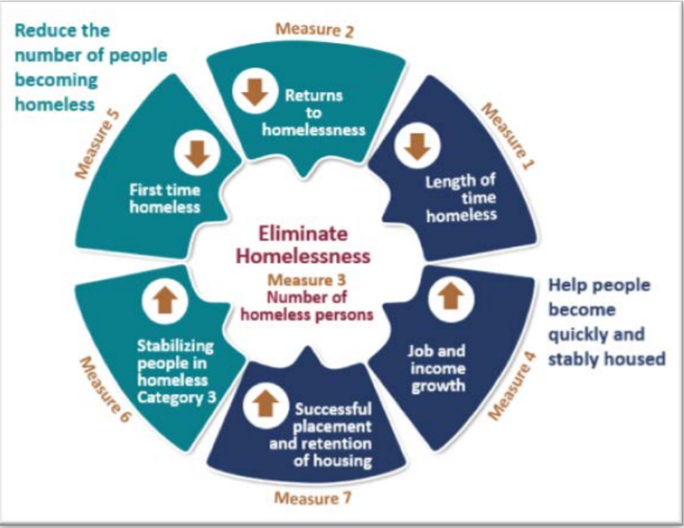
SPM
System Performance Measures:
Helping us understand the effectiveness of our system
Measure 1 – Length of time homeless
Measure 2 – Returns to homelessness
Measure 4 – Job and Income Growth
Measure 7 – Successful placement and retention of housing

Slide 3
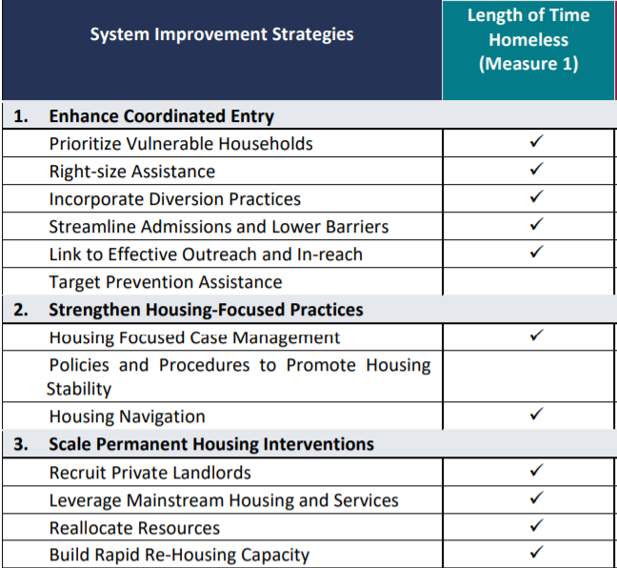
System Performance Measures
Measure 1: Length of time people remain homeless
Goal:
Reduce the average and median length of time that clients remain homeless in ES, SH, TH.
HMIS Data Quality Assessment:
Failing to exit clients will have the biggest negative impact on this measure.
Accurate identification and entry of ‘Approximate Date Homelessness Started’ is crucial for this measure.
Enter Permanent Housing Move In Date for PSH and RRH housed clients!

Slide 4
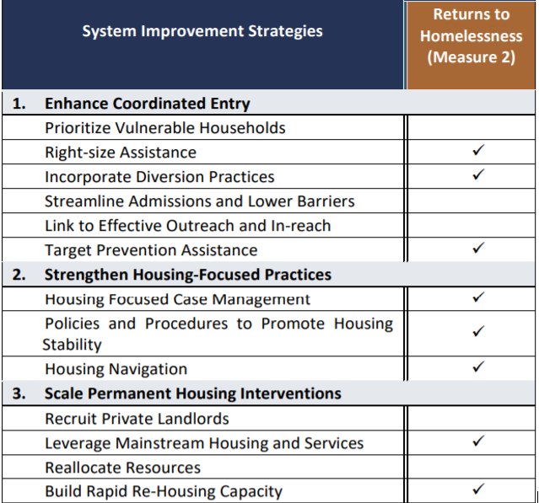
System Performance Measures
Measure 2: Returns to homelessness
Goal:
Reduce the % of returns to homelessness after exits to permanent housing destinations.
HMIS Data Quality Assessment:
Misidentifying exit destinations as permanent can have a negative impact on this measure.
Failure to enter entry and exit dates accurately can impact this measure.

Slide 5
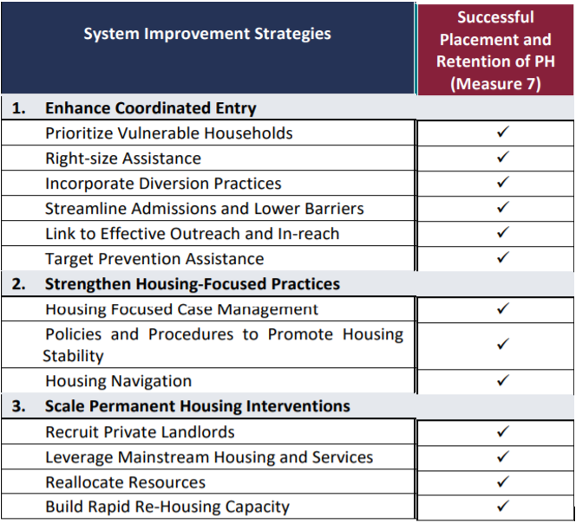
System Performance Measures
Measure 7: Successful placement/retention
Goal:
Increase the % of people who exit to a sheltered or permanent setting or stay in permanent housing.
HMIS Data Quality Assessment:
Misidentifying exit destinations will have a negative impact on this measure.
Enter Permanent Housing Move In Date for PSH and RRH housed clients!

Slide 6
System Performance Measures
Measure 4: Employment and Income Growth
*Changes to a client’s income is used as a criteria for annual CoC program performance ranking.
Goal:
A growing percentage of adults who gain or increase employment or non-employment cash income over time.
How is it measured:
Compares earned income and cash benefits at program entry, annual update and program exit for adult system stayers and leavers.
HMIS Data Quality Assessment:
Failure to input accurate and timely updates of income changes for adult clients will have the greatest negative impact on this measure.

Slide 7
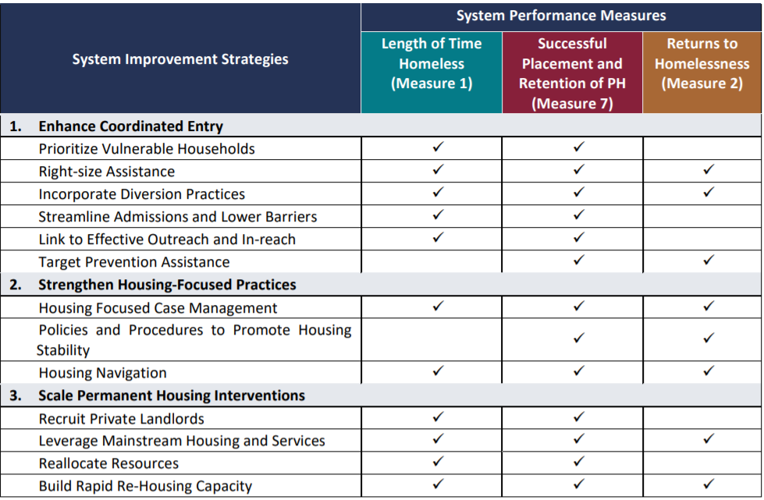
System Improvement Strategies for 3 Key SPMs

Slide 8

Resources
HUD Exchange
www.hudexchange.info
HUD Continuum of Care Program
www.hudexchange.info/programs/coc/
HUD Homeless Management Information System (HMIS)
www.hudexchange.info/programs/hmis/
HUD System Performance Measures
www.hudexchange.info/programs/coc/system-performance-measures/#guidance

