Slide 1
Centering Racial Equity in our Homeless Response Systems: Being Intentional and Thinking Strategically
Mike Giuffrida
mgiuffrida@addressthehomeless.org
Associate Director, Long Island Coalition for the Homeless
In this session we will discuss some of the steps along the way of the ongoing journey of the Long Island NY Continuum of Care to address racial disparities in one of the most racially segregated places in the United States.

Slide 2
Long Island’s Deep-Rooted Racist History and Dynamics
White Suburbia / Most Segregated Suburb in the US
Redlining – Levittown
Robert Moses- Racist Parkway Bridges
Housing Discrimination - Long Island Divided
Many layers of government with local zoning laws that are anti-housing development tied with deep commitment to maintaining a White suburbia
Anti-Housing First sentiment
Large and Competitive NP industry that is Agency Centric
Notes:
>>Insert Hyperlinks
http://mumford.albany.edu/census/newspdf/NYT642002.pdf
https://www.google.com/search?q=levittown+redlining&sxsrf=AJOqlzVwjtMYlfbxu8KfF6koDJsCmNJTrQ:1674227818848&source=lnms&tbm=vid&sa=X&ved=2ahUKEwiGk6nTuNb8AhVfM1kFHfICBnYQ_AUoA3oECAEQBQ&biw=1536&bih=696&dpr=1.25#fpstate=ive&vld=cid:fe3432ee,vid:ZfQaQHi411g
Robert Moses: https://www.npr.org/2020/07/05/887386869/how-transportation-racism-shaped-america
https://projects.newsday.com/long-island/real-estate-investigation-videos/
ADU: https://libn.com/2022/02/03/local-officials-oppose-hochuls-accessory-apartments-plan/
Housing Development: https://www.cbsnews.com/newyork/news/kathy-hochul-long-island-affordable-housing-plan/
Anti-Housing First: https://www.manhattan-institute.org/housing-first-effectiveness
Examples of Community Resistance:
Matinecock: https://patch.com/new-york/northport/east-northport-affordable-housing-green-lit-after-decades-reports
FB group: https://www.facebook.com/stopmatinecockcourt/
Jericho Shelter: https://www.cbsnews.com/newyork/news/jericho-hampton-inn-homeless-shelter/
FB group: https://www.facebook.com/jerichoparents

Slide 3
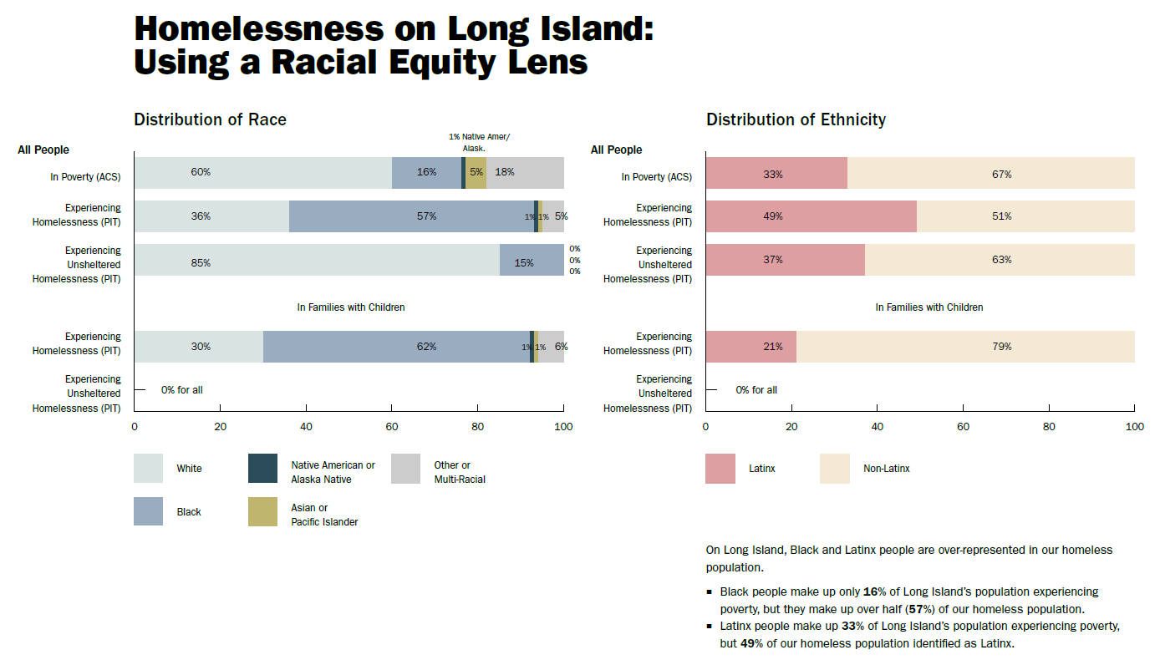
Notes:
Example of local data sets examining race disparities within LI.

Slide 4
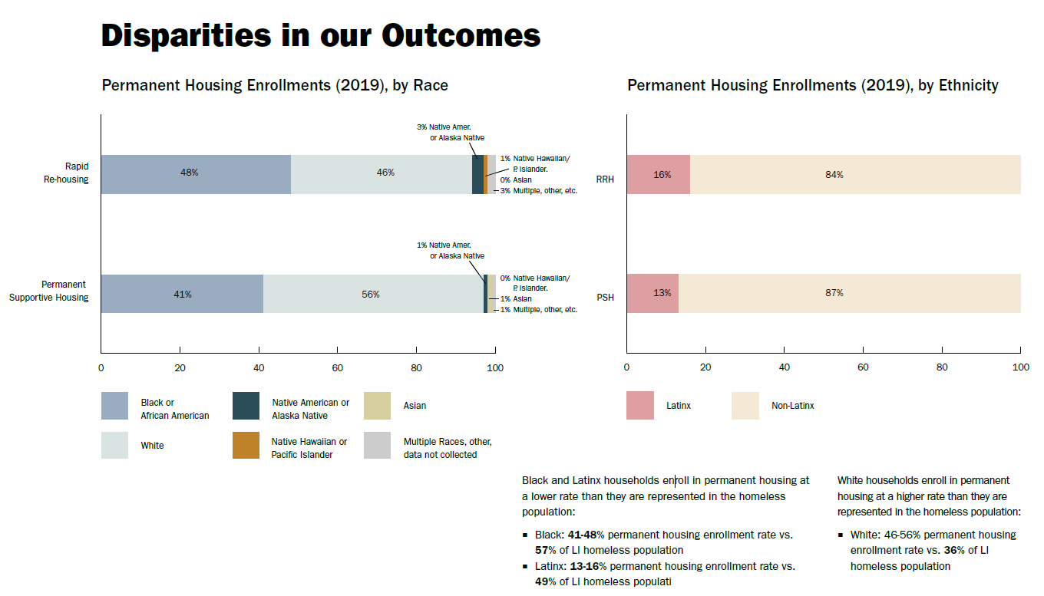

Slide 5
Data Summary
On Long Island, those that identify as Black or Latinx are over-represented in our homeless population.
Person’s that identify as Black make up only 16% of Long Island’s population experiencing poverty, but they make up over half (57%) of our homeless population.
○ Persons that identify as Latinx people make up 33% of Long Island’s population experiencing poverty, but 49% of our homeless population identified as Latinx.
Black and Latinx households enroll in permanent housing at a lower rate than they are represented in the homeless population:
Black: 41-48% permanent housing enrollment rate vs. 57% of LI homeless population
Latinx: 13-16% permanent housing enrollment rate vs. 49% of LI homeless population
White households enroll in permanent housing at a higher rate than they are represented in the homeless population:
○ White: 46-56% permanent housing enrollment rate vs. 36% of LI homeless population

Slide 6
Framing
Data/Statistics
Poverty v. Homelessness
We cannot solve homelessness without addressing systemic racism
Data doesn’t tell the story, people do, and we work for them
Understand how each of us sees and experiences the world
Be humble, take risks, trust the process, progress in not linear
Look in all directions
Equity work is not an etcetera in a job description
Notes:
Opening:
We likely started in the same place as many other communities.
We had data that clearly showed us that something was wrong, and that homelessness was not impacting all communities and people in the same ways. Trying to figure out what to do about it though, or even where to start, was an overwhelming feeling when we already exhausted by the demands of the day to day to work to end homelessness in our community.
We had to make a fundamental shift in our mindset- going from a place of how can we possibly solve homelessness and tackle systemic racism on top of that, to if we do not address system racism, we can never end homelessness.
We didn’t have a clear road map, or extra funding for capacity or support, but we started to identify each crack within our system a focused on each area- attempting to look deeper, ask more questions and keep building on any small successes that we did have.

Slide 7
Our Journey – Focus Areas
Person Centered
Creating Liberated Spaces
Diversity, Equity and Inclusion
Access -> Outcomes -> Experiences
PLE Involvement / Elevating Voices to Create Change
Evaluating Power Dynamics
Reviewing Policies and Procedures
Community Building and Outreach
Notes:
Agency centric environment -> person centered. Make it about people.
Things really started to change when we became more deliberate about creating liberated spaces. Who was in the room started to look different, who was doing the talking versus listening started to look different. Suddenly topics that made the room uncomfortable were the very topics people now wanted to talk about.
We recognized clear blind spots within leadership from all different partners and invested in an extensive three-part DEI training series for all local decision-makers, all those directly involved with Coordinated Entry and the CoC at large.
We reworked our assessment tool an included persons with lived experience in the process. At first, we thought we were creating more equity within our system when we saw more alignment with the presenting population of those experiencing homelessness and those gaining access to housing resources. However, it was only when we looked beyond who was being prioritized and referred, at areas such as successful enrollments, average time to exit from the time of enrollment, especially for programs that included housing searches, and housing retention. And most importantly, the differences in the human experiences' households were having when being referred to the same programs.
After years of failed attempts, we finally created a consistent and formally structured PLE Advisory Group. Our efforts here were much more successful when people felt valued/heard, were being compensated, and scheduling was around their convenience.
And finally, we focused on better balancing power within the CoC, away from what had always been a provider-dominant power structure, which continued to perpetuate agency-centric approaches as opposed to centering approaches around people for far too long.

Slide 8
Coordinated Entry
Outreach
Locations, connections, trust, community response, targeted universalism, accessibility of resources, combating criminalization/police reform
Community building through credible messenger outreach
Assessments
Disparities, barriers, trauma, PLE perspective, consensus, piloting, ongoing review
Process not product
Define vulnerability- how has his contributed to addressing disparities?
Who creates the roadmap?
Prioritization
COVID Response, Equity/Barriers/Trauma, EHV
Length of time homeless, Zip Code (fair housing)
Referrals
Accompanied Intakes, Transition Case Management
Notes:
During COVID-19, street homelessness in our community nearly tripled. With less than one FT Street outreach worker for every 75 people experiencing street homelessness, we did all that we could to try to expand access through enhanced coordination and partnerships, and set up a community response line, where anyone in the community that observed someone that appeared to be living unsheltered, to have a way to easily report that to our street outreach teams. This actually ended up making equity work more difficult as most referrals were pulling street outreach teams in predominantly white middle to upper class neighborhoods, where referrals were motivated by fear and frustration. This allowed us to understand where we were not getting a lot of community referrals from, even though those areas often had higher rates of street homelessness. We created a plan to identify, credible messengers, who from each of communities had trust within that community. We found that each community had different unique challenges and dynamics. We often found ourselves joining local groups and forums to actively listen as opposed to coming in with an agenda or formally presenting on services. We sat in local bereavement groups, re-entry support networks, local church meetings, etc.
During COVID-19, our community quickly adopted an assessment tool that would prioritize those at the greatest risk of COVID-19- with focuses on things like people in congregate settings or on the street and people with underlying medical conditions outlined by the CDC, and we coupled outreach and assessments with health screenings and vaccine outreach. After the height of COVID, we started what ended up being a 14-month process to create a new local tool with the goals of focusing on equity, barriers and trauma, with more built-in diversion and more feedback from persons with lived experience. Our tool is available on our CoC website, but I do caution that each community should develop a tool based on their own local dynamics and that the process of how the tool is developed is much more important for planning.
After years of data, trying different tools, and trying to find the perfect balance of indicators and how they were weighted as part of prioritization, three factors continued to emerge as by and large the most significant in our community when seeking to achieve equitable access to resources. 1) When assessing households already experiencing homelessness, prioritizing length of time homeless continues to lead to the most access to resources for those most disproportionately impacted by homelessness. 2) When assessing households at risk of becoming homeless, prioritizing by whether a household had experienced homelessness before and where someone was currently living led to the most successful targeted use of homeless prevention. Prior to Coordinated Entry, formal assessment tools and prioritization policies, the rates of those getting connected to housing programs for those experiencing homelessness, and the rates of those getting connected to homeless prevention both were significantly perpetuating disparities within our system. In a five-year analysis of ESG homeless prevention programs, we determined that over 85% of households connected to those resources were households that had lower risk levels of becoming homeless.
NYS received a large allocation of EHV, and our CoC saw this as an opportunity to further tackle disparities within our homeless response system. Although our CoC had prioritization policies in place to better ensure equitable access to resources, the real story was the difference in outcomes and experiences for those households. Many households that identified as BIPOC had been prioritized and referred to RRH but had lower rates of successful enrollment, more challenges with housing searches and lower retention.

Slide 9
CoC Planning
Training and Support
CoC Outreach and Recruitment
CoC Restructure Process
PLE Advisory
CoC Monitoring
CoC/ESG Practice Standards
Local Ranking
SNOFO
Housing Search
Notes:
Training- included DEI training series
CoC Outreach, including adding a FT DEI Staff to CoC Planning, more dedicated time for community outreach
CoC Restructure- talk more about on next slide
PLE Advisory- Formally created- consensus, compensation, advisory role to CoC (ie SNOFO review and support letter, shelter concerns)
CoC Monitoring- Human Experience / PLE involvement
Local Ranking- added two sections- one focusing on PLE involvement and one focusing on DEI
Housing Search- outcomes within rental assistance and voucher programs that require housing search process

Slide 10
Gatekeeping and Power Dynamics
Power
Knowledge Gaps
Who is not in the room / at the table?
Diversity v. Inclusion
Key Decision-Making Groups:
CoC Governance- restructure process (PDF/GANTT Chart)
OTDA/DSS- shelter regulations and shelter oversight
OMH- disparities in access to treatment and diagnoses
PHA- local control perpetuates system racism
Notes:
A lot of the discussions that stemmed from our CoC’s DEI training series led to specific actionable items to do better.
Our CoC committed to a complete restructure, starting with our CoC Governance Board. A restructure working group looked at all aspects of the Governance process, from recruitment, to onboarding, to representation, and a formalized PLE Advisory group with more influence. Most of the members of our Governance Board were members of provider agencies, and most were admin staff that were very removed from the day-to-day interactions with people experiencing homelessness.
We’ve united with a statewide coalition of CoCs within the state to force changes to existing shelter regulations and how people are treated in shelters. For our region, this fight focuses around reducing or eliminating the absurd shelter payment rules, where people pay as much as 90% of their income to be in shelter, to 40% of people on the street having no shelter access because of rules around citizenship, to a pilot program with private funds to require each shelter to have a PLE as a member of the leadership team. We’ve also helped launch a legal investigation for those seeking to access shelter that remain on the street because their reasonable accommodations were not being honored.
Other:

Slide 11
Restructure Process Graphic (ICF)
Establish governance workgroup
Identify critical areas for improvement
Draft new governance charter
CoC review and vote on new charter
Establish implementation milestones
Execute implementation plan
Notes:
Discussion can focus on critical areas for improvement and implementation
Areas of improvement
More transparent decision-making practices
New committee structure
More inclusive structure for PLEE via advisory group and designated board seats
Implementation
Milestone items
Strategic outreach plan to educate CoC on governance structure and practices
Implement detailed plan for authentic engagement of PLEE
Implement structured onboarding process for governance board and committees
Structured implementation plan for new committees
Implement governance engagement and retention plan, with focus on accessibility for PLEE

Slide 12
Leadership Reflections
What lenses are we using?
Are we given tools, guidance, and opportunities to succeed?
Who are we speaking with?
Where do we see ourselves in relation to others?
Are we comfortable?

Slide 13
On the right track…
Less talking, more listening
There is room for everyone
Giving up power as a power move that makes us better
Be bold and be willing to be uncomfortable and take risks
Be grounded in values that center around people
Improved outcomes beyond the data
Pressure on our system and other systems
We must believe that it’s possible

