Slide 1
Helpful Benefits for Clients
State and Federal Programs

Slide 2
Types of Benefits We Will Discuss
SNAP
Temporary Assistance
Medicaid
HEAP
SSI/SSDI

Slide 3
SNAP (supplemental nutrition assistance program)
Uploaded monthly on Electronic Benefits Transfer (EBT) card.
Income based.
*Assets such as stocks, retirement, savings accounts etc. are not considered when determining eligibility.
Application can be completed online at https://mybenefits.ny.gov/mybenefits/begin OR by completing the LDSS 2921 Common Application and dropping it off at DSS. Please see copy of application here: https://otda.ny.gov/programs/applications/2921.pdf
SNAP can NOT be used to purchase the following:
Beer, wine, liquor, cigarettes or tobacco
Food that will be eaten in the store
Hot foods
Any nonfood items, such as:
Pet foods
Soaps, paper products
Household supplies
Vitamins and medicines

Slide 4
SNAP Income Guidelines and Maximum Monthly Allotments
Family Size | Monthly Gross Income* | Annual Gross Income*
1 | $1,473 | $17,676
2 | $1,984 | $23,808
3 | $2,495 | $29,940
4 | $3,007 | $36,084
5 | $3,518 | $42,216
6 | $4,029 | $48,348
7 | $4,541 | $54,492
8 | $5,052 | $60,624
Each additional person | $512 + | $6,144 +
Household Size | Maximum Allotment*
1 | $281
2 | $516
3 | $740
4 | $939
5 | $1,116
6 | $1,339
7 | $1,480
8 | $1,691
For each additional member | $211 +

Slide 5
Temporary Assistance AKA Public Assistance
Different types:
Family Assistance (FA)
Provides cash assistance to families who have minor children in the household.
Limited to 60 months of lifetime assistance.
Safety Net Assistance (SNA)
Provides cash assistance to:
Single adults
Childless couples
Children living apart from any adult relative
Families of persons found to be abusing drugs or alcohol
Families of persons refusing drug/alcohol screening, assessment or treatment
Non-citizens who are eligible for TA, but who are not eligible for federal reimbursement

Slide 6
Temporary Assistance cont’d
Emergency Benefits (most likely to apply to our clients):
Helps to resolve urgent need or situation.
You are homeless
You have little or no food
Your landlord has told you that you must move or has given you eviction papers
You do not have fuel for heating in the cold weather period
Your utilities are shut-off or are about to be shut-off, or you have a 72-hour disconnect notice
You or someone in your family has been physically harmed, or threatened with violence by a partner, ex-partner or other household member
Eligibility
Varying income guidelines regarding eligibility depending on housing situation, household size, income type etc.
Client must comply with the following:
Drug and alcohol screening.
Child support payments.
Employment search.*
*If client is unable to work a medical appointment will be scheduled to assess employment ability. If determined able, client must comply with job search.

Slide 7
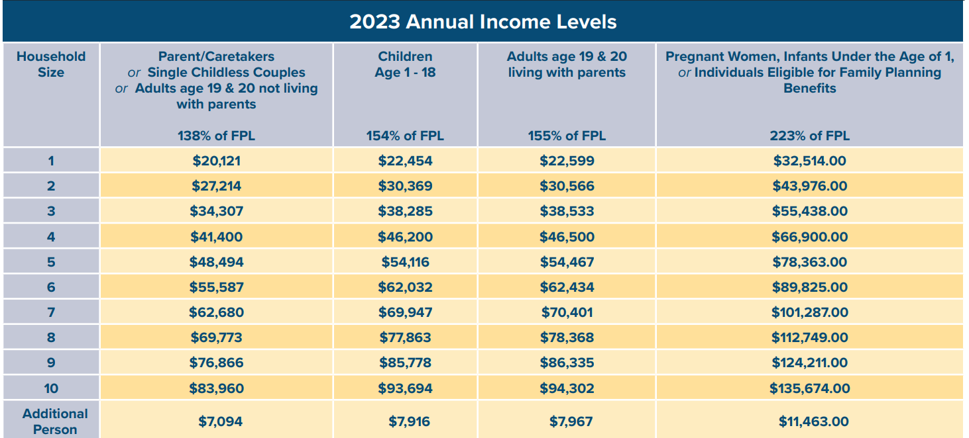
MEDICAID
Two ways to apply:
Through NY State of Health
At local DSS using the LDSS2921 common application https://otda.ny.gov/programs/applications/2921.pdf

Slide 8
HEAP (Home Energy Assistance Program)
Eligible participants can receive one HEAP benefit per season.
Benefits are available starting mid-November through Winter, while funds are available.
Eligibility based
on gross income:
Household Size | Maximum Gross Monthly Income
1 | $2,852
2 | $3,730
3 | $4,608
4 | $5,485
5 | $6,363
6 | $7,241
7 | $7,405
8 | $7,570
9 | $7,734
10 | $7,899
11 | $8,064
12 | $8,228
13 | $8,778
Each additional | Add $590

Slide 9
Nassau County HEAP contacts
Department of Social Services
Nassau County Department of Social Services
60 Charles Lindbergh Boulevard Uniondale, NY 11553 Phone: (516) 227-8519 Days Open: Monday-Friday, 9:00am-4:45pm
Alternate Certifiers
Family and Children's Association: Office for the Aging
60 Charles Lindbergh Boulevard, 2nd Floor Uniondale, NY 11553 Phone: (516) 227-7386 Days Open: Monday-Friday, 9:00am-4:45pm
Alternate Certifiers
EAC
175 Fulton Avenue, 4th floor Hempstead, NY 11550 Phone: (516) 565-4327 Days Open: Monday-Friday, 9:00am-4:45pm
After Hours Emergency Contact
Nassau County Department of Social Services Emergency Services
Phone: (516) 573-8626 Days Open: Monday - Friday

Slide 10
Suffolk County HEAP contacts
Department of Social Services
Suffolk County Department of Social Services
PO Box 18100 200 Wireless Boulevard Hauppauge, NY 11788 Phone: (631) 853-8825 Days Open: Monday-Friday, 8:30am-4:30pm
Department of Social Services
Suffolk County Department of Social Services
80 Middle Country Road Coram, NY 11727 Phone: (631) 854-2300 Days Open: Monday-Friday, 8:30am-4:30pm
Department of Social Services
Suffolk County Department of Social Services
893 East Main Street Riverhead, NY 11901 Phone: (631) 852-3500 Days Open: Monday-Friday, 8:30am-4:30pm
Department of Social Services
Suffolk County Department of Social Services
2 South Second Street Deer Park, NY 11729 Phone: (631) 854-6600 Days Open: Monday-Friday, 8:30am-4:30pm
Alternate Certifiers
Suffolk County Office for the Aging (OFA)
PO Box 6100 100 Veterans Memorial Hwy, H. Lee Dennison Bldg. Hauppauge, NY 11788 Phone: (631) 853-8326 Days Open: Monday-Friday, 8:30am-4:30pm
After Hours Emergency Contact
Emergency Services
Phone: (631) 854-9100 Days Open: Monday-Friday, 4:30pm-12:00am, Weeknds & Holidays 8:00am-12:00am

Slide 11
SSDI and SSI (Social Security Disability Insurance/Supplemental Security Income)
Similarities: While SSDI and SSI are different programs hey do both require the client meet strict medical criteria including a diagnosis proving the client is unable to work to the point of Substantial Gainful Employment.
A listing of diagnostic criteria can be found in the “Blue Book”, the link can be found here:
https://www.ssa.gov/disability/professionals/bluebook/AdultListings.htm
What’s the difference?
SSI: Needs based program, eligibility based on client’s financial and living situation. Work credits do not apply.
SSDI: Based on one’s earned Social Security work credits, determined from client’s lifetime work experience.

Slide 12
Social Security Retirement
Eligibility:
Client must be 62 years or older.
Client must have worked and paid into Social Security for a minimum of 10 years.
Please direct clients to the below link to verify their eligibility
https://www.ssa.gov/prepare/check-eligibility-for-benefits

Slide 13
Implementing SOAR for our clients
What is SOAR?
Designed to help states increase access to SSI/SSDI for eligible adults who are experiencing or at risk of homelessness and have a serious mental illness, medical impairment, and/or a co-occurring substance use disorder.
Encourages a collaborative process.
Facilitates communication among SSI/SSDI benefit applicants, case managers, SSA, Disability Determination Services (DDS), and community providers.
Prepares case managers to assume a central role in gathering complete, targeted, and relevant information for SSA and DDS.
Helps the disability determination process move more smoothly and quickly by providing assistance to SSA and DDS.
Seeks approval on initial applications, avoiding the need for appeals.
Works to increase access to supportive services and employment opportunities.

Slide 14
Barriers and Challenges SOAR helps to overcome
SSA communicates mainly by mail, which is a challenge when one does not have a permanent, reliable address.
People who are experiencing homelessness often have sporadic medical care, making it difficult to access medical records to document disability.
Symptoms can interfere with cognitive functioning, making it difficult to navigate a complex system.

Slide 15
SOAR works
Since 2006, 50 states and the District of Columbia have reported 53,877 approvals on SOAR-assisted initial applications for adults.
Applying the SOAR model has resulted in an approval rate of 68 percent in an average of 153 days.
The average cumulative approval rate for our "Top 10" states is 81%! In order of highest average cumulative approval rate, the Top Ten states are: Pennsylvania, Tennessee, Maryland, Arkansas, North Carolina, Wyoming, Oklahoma, Virginia, Washington, DC, and Nevada

Slide 16
Sources
New York State of Health
https://info.nystateofhealth.ny.gov/Medicaid
New York State Office of Temporary and Disability Assistance
https://otda.ny.gov/programs/
Social Security Administration
https://www.ssa.gov/
SAMSHA
https://soarworks.samhsa.gov/

