Slide 1




Understanding the McKinney-Vento Act: Ensuring Access

Slide 2


1. What is the McKinney-Vento Act?
4. Educational Stability:
a. Umbrella Overview
2. Authorized Programs
a. Definition of homelessness under the McKinney-Vento Act
c. Roles & Responsibilities Liaisons and School Districts
b. Transportation & Support services
3. Eligibility & Access
a. Housing & Other Programs
b. Education Subtitle
a. Enrollment Rights and Support
b. History

Slide 3


Overview
McKinney Vento is an extensive federal law that authorizes a number of housing and homelessness programs that are administered by HUD but also includes an education subtitle focusing on the education of homeless youth.
Subtitle B of the McKinney-Vento Homeless Assistance Act is a federal law that ensures homeless children and youth have access to a free, appropriate public education.

Slide 4
History of McKinney-Vento?
1987
Congress enacted the Stewart B. McKinney Vento Homeless Assistance Act in response to the homelessness crisis that emerged in the 1980s.
2000
The act was renamed the Mckinney-Vento Homeless Assistance Act
2009
Congress passes the The Homeless Emergency Assistance and Rapid Transition to Housing (HEARTH) Act
consolidates three of the separate homeless assistance programs administered by HUD under the McKinney-Vento Homeless Assistance Act into a single grant program—the Continuum of Care (CoC) Program.
2015
Subtitle VII-B of the Mckinney-Vento Homeless Assistance act reauthorized in December 2015 by Title IX, Part A, of the Every Student Succeeds Act (ESSA)
HEARTH Act amended to allow non-profits to administer rental assistance under the CoC program
Notes:
2022 Advocates' Guide (nlihc.org)

Slide 5

HUD’s McKinney-Vento Funded programs
ESG Program
Continuum of Care (CoC) Program.
Notes:
Eligible activities under thse programs are to
Provide outreach,
shelter,
transitional housing,
supportive services,
short- and medium-term rent subsidies,
and permanent housing
for people experiencing homelessness and in some cases for people at risk of homelessness

Slide 6
Other Programs Authorized by the Mckinney-Vento Act
The Education for Homeless Children and Youth (EHCY) Program
Administered by the U.S. Department of Education
Provides grants to schools to aid in the identification of children experiencing homelessness and provide services to help them succeed in school.
EHCY also requires schools to make accommodations to improve the stability of homeless children’s education.
Title V Surplus Properties
Requires that federal surplus property be offered to nonprofit organizations for the purpose of assisting people experiencing homelessness.
The Interagency Council on Homelessness
An independent agency within the federal executive branch, coordinates the federal response to homelessness and is charged with creating a federal plan to end homelessness.
Notes:
2022 Advocates' Guide (nlihc.org) **

Slide 7

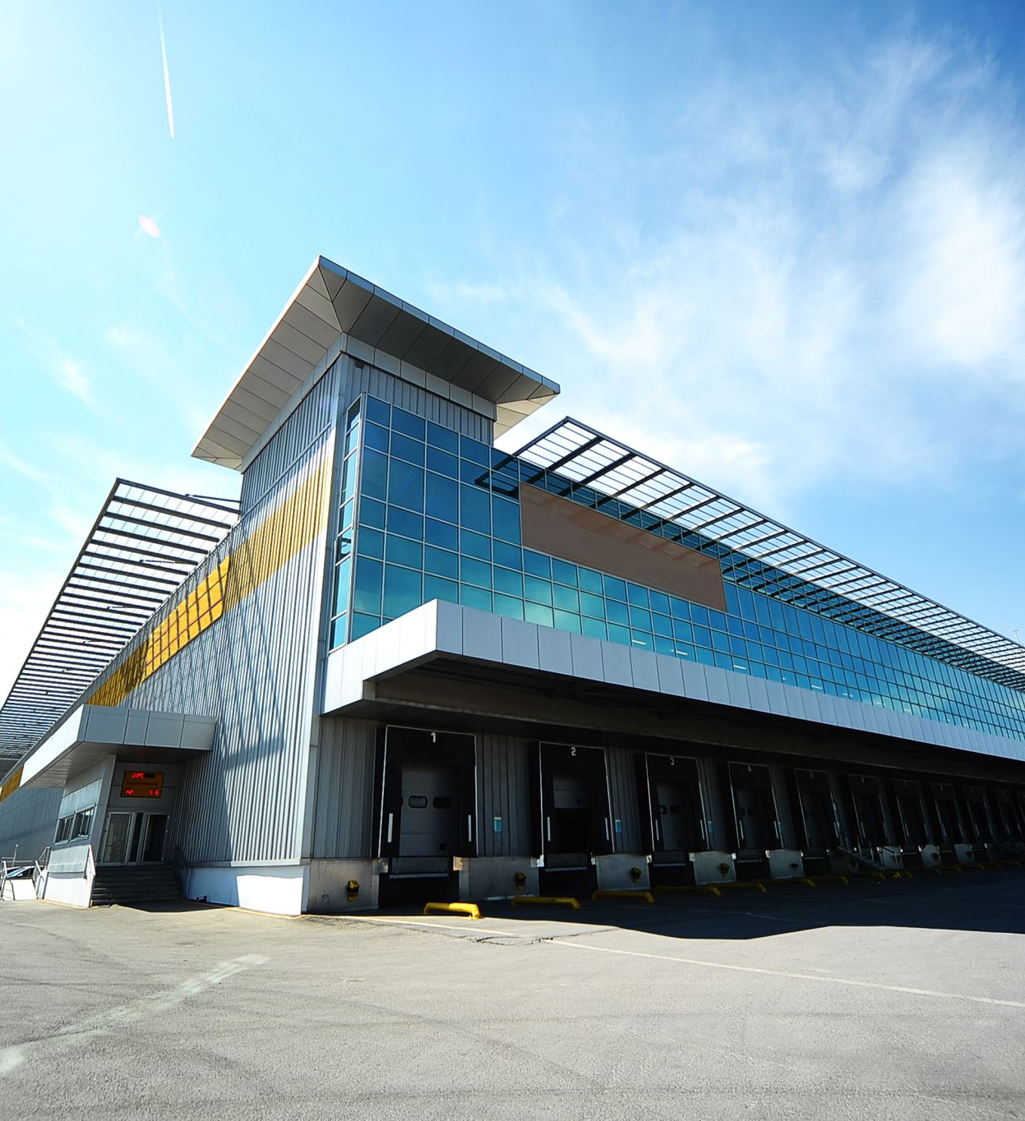
What is the Title V Program?
Title V of the McKinney-Vento Homeless Assistance Act, Public Law 101-645 ( 42 U.S.C. 11411 ),
  enables eligible organizations to use unutilized, underutilized, excess, or surplus federal properties to assist persons experiencing homelessness.
Eligible applicants are states, local governments, and nonprofit organizations.
Notes:
Surplus Property for Use to Assist the Homeless (Title V) | HUD.gov / U.S. Department of Housing and Urban Development (HUD)

Slide 8
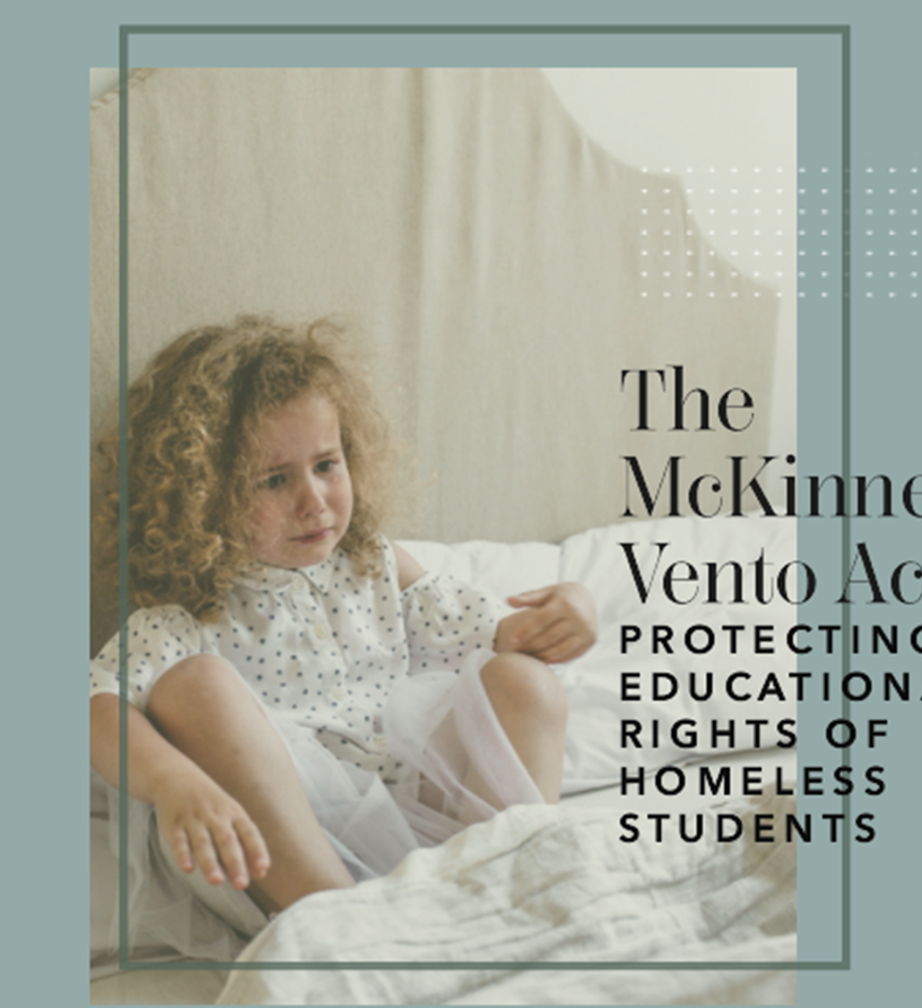
Part B – Education for Homeless Children and Youth
Subtitle VII-B of The McKinney-Vento Homeless Assistance Act authorizes the federal Education for Homeless Children and Youth (EHCY) Program
Notes:
McKinney-Vento – National Center for Homeless Education
42 USC CHAPTER 119, SUBCHAPTER VI, Part B: Education for Homeless Children and Youths (house.gov)

Slide 9
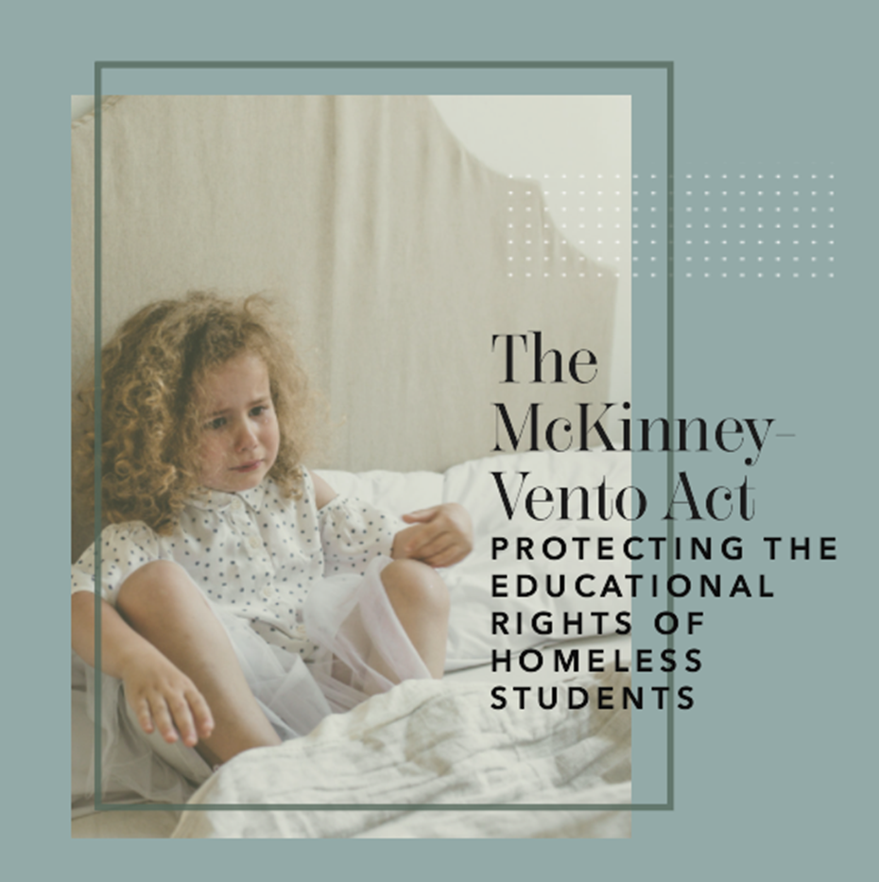
2. Eligibility & Access
a. Definition of homelessness under the McKinney-Vento Act
b. Roles & responsibilities of school districts

Slide 10

Definition of homelessness under the McKinney-Vento Act (42 U.S.C. $ 1143a)
§11434
For purposes of this part:
(1) The terms "enroll" and "enrollment" include attending classes and participating fully in school activities.
(2) The term "homeless children and youths"—
(A) means individuals who lack a fixed, regular, and adequate nighttime residence (within the meaning of section 11302(a)(1) of this title); and
(B) includes—
  (i) children and youths who are sharing the housing of other persons due to loss of housing, economic hardship, or a similar reason; are living in motels, hotels, trailer parks, or camping grounds due to the lack of alternative adequate accommodations; are living in emergency or transitional shelters; or are abandoned in hospitals;
  (ii) children and youths who have a primary nighttime residence that is a public or private place not designed for or ordinarily used as a regular sleeping accommodation for human beings (within the meaning of section 11302(a)(2)(C) ¹ of this title);
  (iii) children and youths who are living in cars, parks, public spaces, abandoned buildings, substandard housing, bus or train stations, or similar settings; and
  (iv) migratory children (as such term is defined in section 6399 of title 20) who qualify as homeless for the purposes of this part because the children are living in circumstances described in clauses (i) through (iii).

Slide 12
Distribution of MCV students housing enrolled by nighttime residence: identification challenges

Slide 13
Understanding substandard housing
Housing standards may vary by locality
Considerations:
  Does the housing lack one of the fundamental utilizes such as water electricity or heat?
  Is the housing infested with vermin or mold?
  Does the housing lack a basic functional part such as a working kitchen or working toilet?
  Shared housing arrangements are often unsustainable or are offered by unscrupulous hosts
Does the housing present unreasonable dangers to adults children's or persons with disabilities…each city county sate may have its own housing code that further define what may be deemed substandard housing…check local jurisdiction

Slide 14

Role of Liaisons & School District
School District MCV Liaison
  Role in identifying and determining eligibility
  Assisting students in getting services

Slide 15
Roles and responsibilities of Liasons and School Districts
The local liaison has the authority and responsibility to ensure that eligible students are identified, this should be a collaborative effort with the school personal and through outreach and coordination activities with other entities and agencies(42 U.SC. 11432 (g(6)(A)(i)
Eligibility determinations should be made on a case by case basis considering the circumstances of each student
Pay close attention to legislation wording as it may provide needed clarity

Slide 16
Mckinney-Vento Services Can provide
Barriers & Needs for students experiencing homelessness
Not have access to reliable transportation
Not have school supplies or a quiet place to study
Be hungry tired and stressed
Move around and change schools a lot
Be unable to meet standard school enrollment
Busing
Provide supplies
Provide free meals, counseling and
Allow to stay enrolled in school of choice/home district
Allow to enroll immediately without proper documents

Slide 17
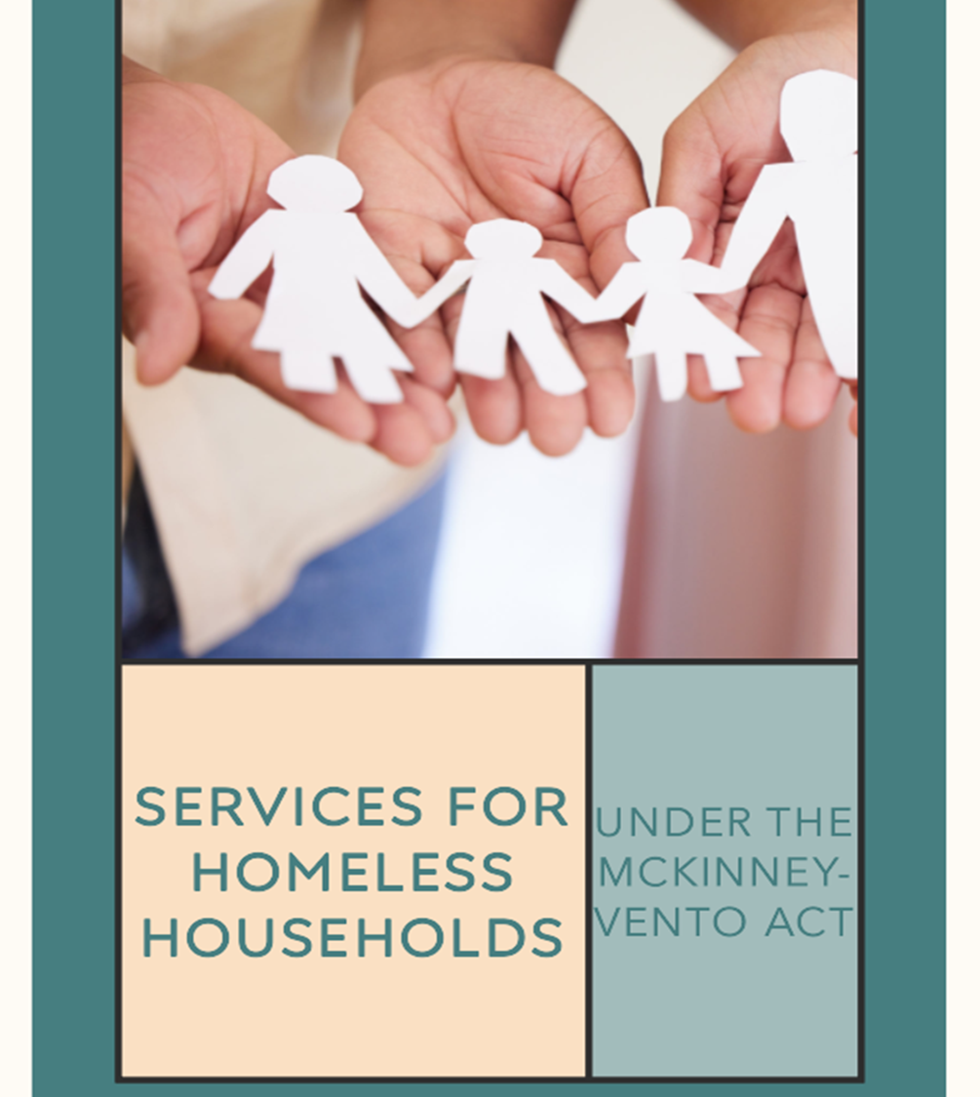
1. Immediate Enrollment:
2. School of Origin:
3. Educational Stability:
4. Support for School Transitions:
5. Access to Free School Meals:
6. Referrals to Supportive Services:
7. Educational Services and Programs:
Homeless students have the right to remain in their school of origin, which is the school they attended before becoming homeless.
Homeless students may face multiple school transitions due to their housing instability.
Homeless students are automatically eligible for free school meals
Schools must connect homeless students and their families with available support services
Homeless students have the right to access the same educational programs and services as their housed peers.
Schools must ensure educational stability for homeless students.
Homeless students have the right to enroll in school immediately
Notes:
3. Schools must ensure educational stability for homeless students.
If remaining in the school of origin is not in the student's best interest, schools must provide immediate enrollment in a new school.
They should minimize educational disruptions, provide comparable services, and facilitate the transfer of academic records.
4. Homeless students may face multiple school transitions due to their housing instability.
The McKinney-Vento Act requires schools to provide support services to facilitate these transitions,
including assistance with enrollment,
credit transfer,
and academic and social integration.
5. Homeless students are automatically eligible for free school meals without the need for additional applications.
This ensures they have access to nutritious meals during the school day.
6. Schools must connect homeless students and their families with available support services
such as health care
mental health services
counseling
and other resources in the community.
7. Homeless students have the right to access the same educational programs and services as their housed peers.
School districts must provide homeless students with the same educational opportunities as other students,
including access to the same programs, services, and activities.
Schools should provide additional supports, such as tutoring, after-school programs, and supplemental instruction, to help homeless students succeed academically.

Slide 18

Immediate Enrollment & School Selection
School districts must immediately enroll homeless students, even if they lack documents normally required for enrollment, ie:
  previous academic records,
  medical records,
  proof of residency,
  or other required documents.

Slide 19

Transportation
The law requires school districts to provide transportation to and from the school of origin for homeless students.

Slide 20
Maintaining Eligibility & the Terminal Year
Yes, a student who qualifies for McKinney-Vento services retains their McKinney-Vento status for the duration of the school year. The McKinney-Vento Act ensures that eligible homeless students have the right to immediate enrollment and remain in their school of origin, if it is in their best interest, for the entire school year, even if their housing situation changes during that time.
This means that even if a homeless student's housing situation stabilizes or changes throughout the school year, they can continue to receive support and services under the McKinney-Vento Act until the end of that school year. The intent is to provide stability and continuity in their education despite the challenges they may face due to homelessness.
Schools should work with homeless students and their families to provide necessary support, including transportation services, referrals to support services, and assistance in accessing educational resources, to help them succeed academically while experiencing homelessness.
Notes:
NYSED Guidance: Education of Children and Youth Expperiencing Homelessness

Slide 21
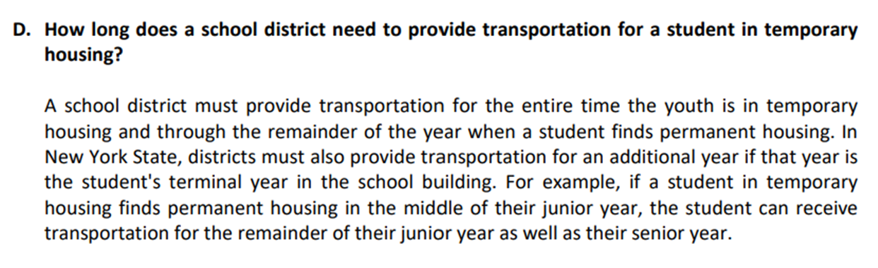
The Terminal Year
Notes:
i. Transportation as described in this subdivision must be provided to
the homeless child by the designated school district of attendance or
the social services district for the duration of homelessness. The
designated district of attendance must transport the child for the
remainder of the school year in which the child becomes permanently
housed and one additional year if that year constitutes the child's
terminal year in the designated school. Such transportation shall not be
in excess of fifty miles each way except where the commissioner
certifies that transportation in excess of fifty miles is in the best
interest of the child. The designated school district of attendance
shall be entitled to reimbursement from the current school district in
which the child becomes permanently housed for any cost incurred for
transportation for the remainder of the school year after the child
becomes permanently housed and one additional year if that year
constitutes the child's terminal year in the designated school.

Slide 22

Conclusion
The McKinney-Vento Act plays a crucial role in ensuring that homeless students have access to quality education and the support they need.

Slide 23
Contacts & Responsible Parties
State
  State Education MCV Coordinator
    New York:
Local
  MCV District Liaisons
    Nassau & Suffolk Counties: MKV Contact List.xlsx
Liasons | NYSTEACHES
Notes:
MVDeterminingEligibility - YouTube

Slide 24

Resources
Resource Library | NYSTEACHS
Training Resources
  McKinney-Vento Toolbox – National Center for Homeless Education
  Self-Paced Online Training – National Center for Homeless Education
  When Working Together Works (ed.gov)
Legislation
  View the full text of the McKinney-Vento Homeless Assistance Act (Title IX, Part A of ESSA).
  View the McKinney-Vento Definition of Homelessness (legislative excerpt).
  View McKinney-Vento subgrant funding authorized activities (legislative excerpt)
Notes:
NoBarriers.pdf (homelesslaw.org)

Slide 25
McKinney-Vento Related 2023 NOFO Questions
1C-4. CoC Collaboration Related to Children and Youth–SEAs, LEAs, School Districts.
1C-4b. Informing Individuals and Families Experiencing Homelessness about Eligibility for Educational Services.
1C-4c. Written/Formal Agreements or Partnerships with Early Childhood Services Providers.

Slide 26

Questions?

